Slide 1
ADAPTING MARS ENTRY, DESCENT AND LANDING SYSTEM FOR EARTH
J. Heilimo*⁽¹⁾, S. Aleksashkin⁽²⁾, A.-M. Harri⁽¹⁾, H. Guerrero⁽⁴⁾,
V. Koryanov⁽³⁾, H. Haukka⁽¹⁾, W. Schmidt⁽¹⁾, T. Siili⁽¹⁾, V. Finchenko⁽²⁾, M. Martynov⁽²⁾, B. Ostresko⁽²⁾,
A. Ponomarenko⁽²⁾, V. Kazakovtsev⁽³⁾, S. Martin⁽⁴⁾,
Notes:
Esityksen rakenne
RITD projekti ja Metnet
MetNetin laskeutumisprofiili
Laskeutujan rakenne

Slide 2






RITD Project team
(1)
(2)
Lavochkin Association
Bauman Moscow State Technical University
(3)
Institutio Nacional de Técnica Aerospacial
(4)
http://ritd.fmi.fi

Slide 3
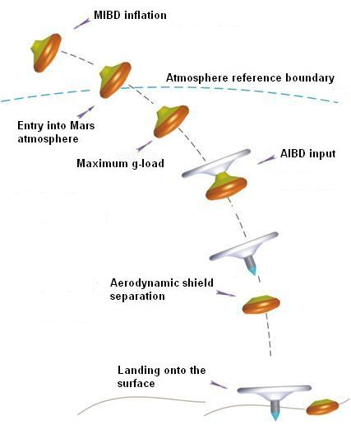
RITD Project scope
Mars MetNet Landers (MML)
  Semihard landing to Mars
  Two phase Inflatable EDLS
Can the same EDLS be used for Earth entry?
Stability during transsonic phase?
Scaling and modifications required?

Slide 4
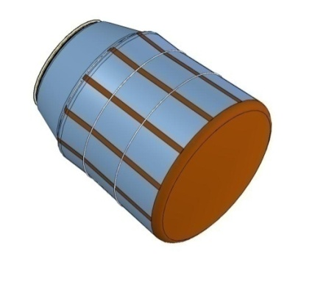
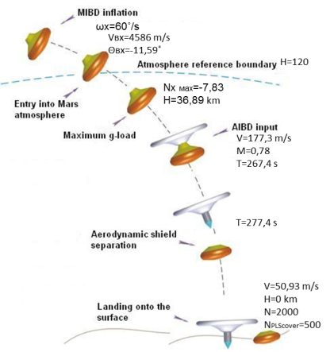
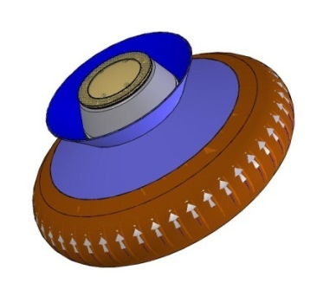
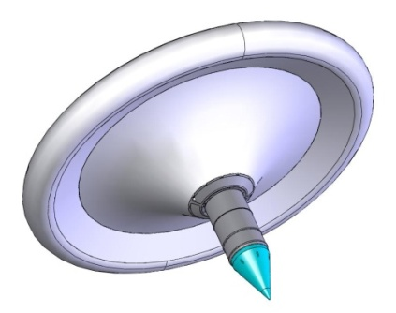
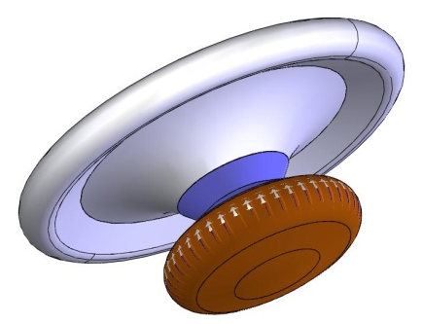
MetNet Descent Vehicle
MIBD inflation
Main Parameters of MML
AIBD inflation
PARAMETER | VALUE
Vehicle mass | 22.2 kg
Payload mass | 4.0 kg
Landing speed | 55.4 m/s
Diameter of MIBD | 1m
Diameter of AIBD | 2m
Front shield separation

Slide 5
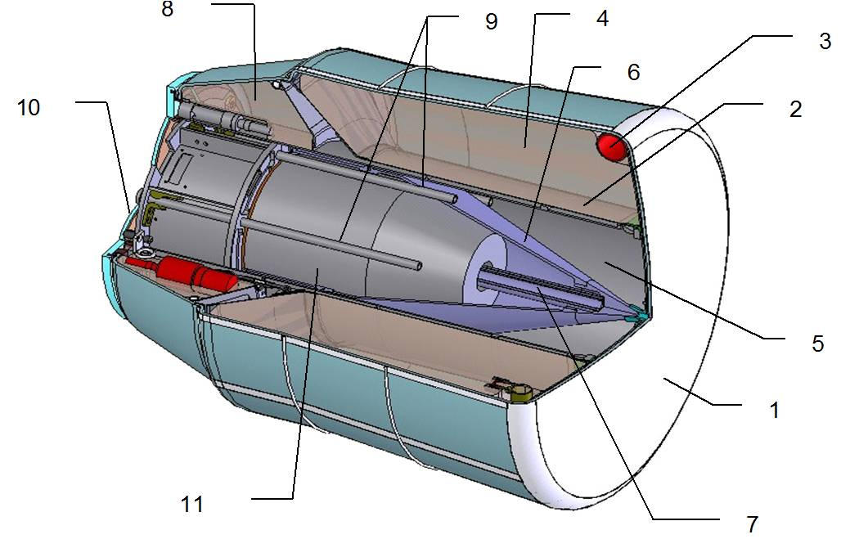
MetNet descent vehicle structure
AIBD
Shock absorber
MIBD
MIBD
MIBD inflation system
Movable cone
MIBD
Cover
AS body
DV body
Aerodynamic shield (AS)
Payload container
Movable cone drive

Slide 6
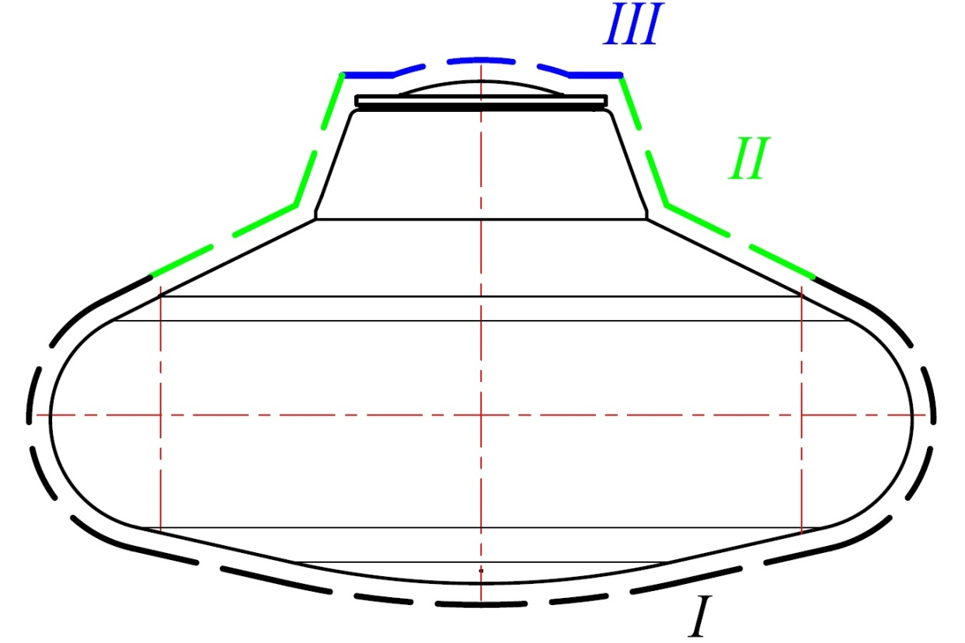
Structure of MetNet DV TPC
Flexible TPC:
Heat-insulating mat – MLI
Sublimating material on outer surface of the mat (T<600⁰С)
Rigid TPC:
Sublimating radiolucent material.
Sublimation temperature T=600⁰С
Flexible TPC:
Thermal protection jacket
two layers of MLI fabric (Т<1200 ⁰С), sublimating material

Slide 7
Aim: study of feasibility of MetNet DV entry into the Earth atmosphere.
Criteria:
Minimum deformation of MIBD shape;
Thermal and mechanical loads to DV structure shall within limits;
Descent Vehicle dynamic stability during descent.
Factors affecting DV atmospheric motion:
Atmospheric density and composition;
Re-entry velocity - Ventry;
Angle of re-entry - θentry.
Parameters of thermal loading simulation:
level of specific heat flux to MetNet DV mockup surface;
value of specific quantity of heat falling to MetNet DV mockup surface;
value of MetNet DV mockup thermal protection ablation.

Slide 8
Analysis of conditions of DV entry into the Earth atmosphere, meeting thermal loading design parameters
V_{entry}
θ_{entry}
Estimation of the trajectory of DV motion in the Earth atmosphere
Analysis of DV motion dynamics with regard to the center of gravity
Conclusions

Slide 9
Analysis of conditions of DV entry into the Earth atmosphere meeting thermal loading parameters
Results of analysis of 120 variants of trajectories
V_{entry}= 5250 m/s
θ_{entry}=-3 deg.
Table of correspondence of thermal parameters at DV descending in the Earth and Mars atmospheres
Entry velocity, m/s | Angle of entry, deg | Time of thermal action, s | Heat flux, КW/m² | Quantity of heat, МJ/m² | TPC ablation, mm | Sublimation duration, s | Dynamic pressure, kPа
The Earth – 5250 | - 3.00 | 150 | 303 | 12.5 | 1.40 | 56 | 2.29
Mars – 4586 | - 9.49 | 200 | 190 | 11.7 | 1.38 | 72 | 1.2

Slide 10
Heat flux to MetNet DV TPC
Mars (θ_{entry} = – 9.49°; V _{entry} = 4586 m/s)
The Earth (θ _{entry} = – 3.00°; V _{entry} = 5250 m/s)
q, kW/m²
q, kW/m²
t, s
t, s

Slide 11
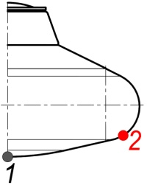
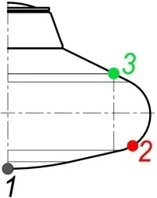
Ablation of sublimating material from TPC surface
Mars (θ_{entry} = – 9.49°; V _{entry} = 4586 m/s)
The Earth (θ _{entry} = – 3.00°; V _{entry} = 5250 m/s)
∆δ, mm
∆δ, mm
t, s
t, s
Linear ablation of sublimating material along the trajectory of descent

Slide 12
PLC cover temperature
Mars (θ_{entry} = – 9.49°; V _{entry} = 4586 m/s)
The Earth (θ _{entry} = – 3.00°; V _{entry} = 5250 m/s)
T, ˚C
T, ˚C
black curve –
outer surface of TPC
red curve –
PLC cover
black curve –
outer surface of TPC
red curve –
PLC cover
t, s
t, s
Dynamics of DV PLC cover temperature condition along the trajectory of descent

Slide 13
Variation of DV altitude vs. time of descent
Mars
The Earth
Altitude, m
Altitude, m
Time, s
Time, s
Descent trajectory

Slide 14
DV velocity vs. time of descent
Mars
The Earth
Velocity, m/s
Velocity, m/s
Velocity, m/s
Velocity, m/s
Time, s
Time, s
Velocity variation along the trajectory of descent

Slide 15
Dynamic pressure
Mars
The Earth
Dynamic pressure, Pa
Dynamic pressure, Pa
Time, s
Time, s
Dynamic pressure variation during the descent

Slide 16
G-load
Mars
The Earth
G-load, unit
G-load, unit
Time, s
Time, s
Axial g-load variation during the descent

Slide 17
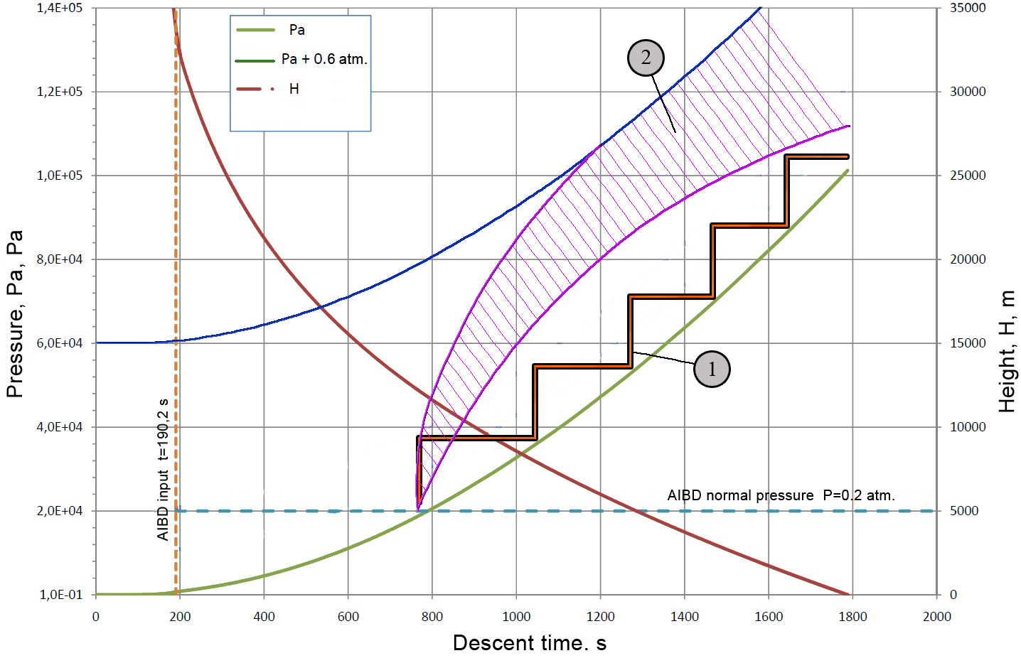
AIBD pressurization scheme
Inflation System
Variant 1
Pyrotechnic Gas Generator (PGG)
PGG
...
PGG
5 items
Mass – 2.5 kg
Inflation System
Variant 2
PGG
Gas
tank
Pyrovalve and hoses
Mass – 1.5 kg

Slide 18
Dynamics of MetNet DV angular motion at its descending in the atmosphere
Variation of spatial angle of attack vs. time
Variation of transverse angle rates

Slide 19
Conclusions
Entry conditions V_{entry} = 5250 m/s, θ_{entry} = -3 deg are feasibile for MetNet DV descend and landing to the Earth atmospere.
TPC ablation and thermal protection temperature conditions are comparable.
At stabilization of DV by spinning and oriented entry into the Earth atmosphere the MetNet DV preserves stability along the whole path. Angular motion characteristics are preserved.
The mechanical loads to MIBD due dynamic pressure interaction practically coincide.
In Earth conditions, due to more dense atmosphere at altitudes below 12 km, staged pressurization of AIBD is required. The pressurization system will increase DV mass by 1.5-2.5 kg (depending of chosen variant).

