Slide 1
An Overview of Japan’s Planetary Probe
Mission Planning
9th International Planetary Probe Workshop
Toulouse, France
June 2012
K. Fujita
JAXA Space Exploration Center
Japan Aerospace Exploration Agency

Slide 2
JAXA’s Planetary Exploration Mission Roadmap
Overview of scheduled and proposed missions
2008 | 2009 | 2010 | 2011 | 2012 | 2013 | 2014 | 2015 | 2016 | 2017 | 2018 | 2019 | 2020 | 2021 | 2022 | 2023 | 2024
KAGUYA
(SELENE)
SELENE-2
SELENE-X
HAYABUSA
(MUSES-C)
HAYAUBSA-2
HAYABUSA-Mk2
MELOS1
MELOS2
Jupiter-Trojan
Asteroids Exploration
DASH-II Demo.
Venus Balloon
IKAROS
Mars Aerocapture Demo.
AKATSUKI (Planet-C)
Related science missions
BepiColombo
Notes:
Mars Exploration with Landers and Orbiters Synergy (MELOS) is currently entertained in Japan Aerospace Exploration Agency (JAXA) in collaboration with a large number of planetary science groups over Japan.
As its name suggests, the MELOS mission is designed as a conglomerate mission, in which orbiters, landers, rovers, and/or airplanes are used for aeronomical, meteorological, and geoscientific researches as well as life search to reveal why Mars is now in red, that is, the fate of ancient water and carbon dioxide on the course of Martian history.
In the mission scenario, the landers and the orbiters are transported to Mars and initially inserted into an extended elliptic orbit altogether, then the landers are transferred into the atmospheric entry orbit by using the orbiter as the entry service module, after which the orbiters are maneuvered to their respective final orbit. Such a mission scenario has great potential for a variety of probe vehicles incorporated into the MELOS mission. In this article, as one of the candidate subsystems for the MELOS mission, a Mars Aeroflyby Sample Collection (MASC) system using the aeroassist orbit transfer (AOT) technologies is proposed.

Slide 3
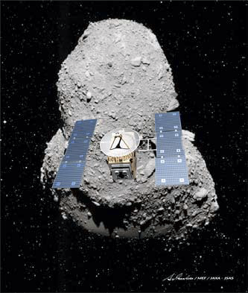
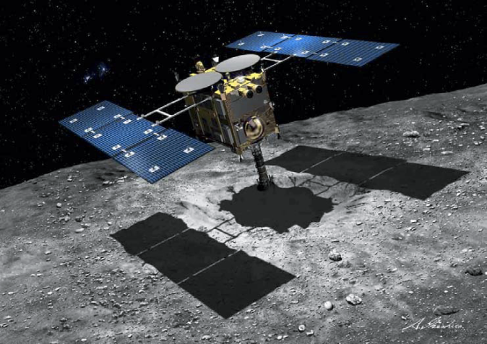
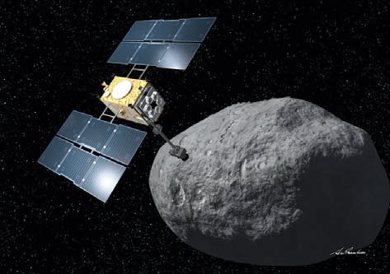
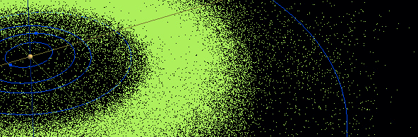
HAYABUSA-2 (1/5)
Primitive body exploration program proposed in JAXA
03 | 04 | 05 | 06 | 07 | 08 | 09 | 10 | 11 | 12 | 13 | 14 | 15 | 16 | 17 | 18 | 19 | 20 | 21 | 22 | … future
HAYABUSA
HAYABUSA-2
HAYABUSA-Mk2
S-type
Itokawa
S-type
Itokawa
S-type
Itokawa
Propelled by ion engines
Propelled by Solar Power Sail
Sample return from more primitive aster-oids located at a fur-ther distance, using higher technologies
S-type (ITOKAWA)
C-type (1999 JU3)
D-type asteroid
Notes:
Mars Exploration with Landers and Orbiters Synergy (MELOS) is currently entertained in Japan Aerospace Exploration Agency (JAXA) in collaboration with a large number of planetary science groups over Japan.
As its name suggests, the MELOS mission is designed as a conglomerate mission, in which orbiters, landers, rovers, and/or airplanes are used for aeronomical, meteorological, and geoscientific researches as well as life search to reveal why Mars is now in red, that is, the fate of ancient water and carbon dioxide on the course of Martian history.
In the mission scenario, the landers and the orbiters are transported to Mars and initially inserted into an extended elliptic orbit altogether, then the landers are transferred into the atmospheric entry orbit by using the orbiter as the entry service module, after which the orbiters are maneuvered to their respective final orbit. Such a mission scenario has great potential for a variety of probe vehicles incorporated into the MELOS mission. In this article, as one of the candidate subsystems for the MELOS mission, a Mars Aeroflyby Sample Collection (MASC) system using the aeroassist orbit transfer (AOT) technologies is proposed.

Slide 4
HAYABUSA-2 (2/5)
Purpose of HAYABUSA-2
  Science
  To answer “Where did we come from?”
    The origin and evolution of the solar system
    The original material of life
    The origin of the water of the ocean
  Engineering
  To develop original and unique technologies for exploration of solar system
    New technology used for Hayabusa → more reliable and robust
    New challenges : ex) impactor, small rover, …
  Exploration
  To extend the area that human being can reach
    Return trip
    Space-guard, Resources, Research for manned missions, etc.
Reproduced from
“The Hayabusa2 Mission of JAXA”
COSPAR Planetary Protection Colloquium 2012
Alpbach, Austria, 31 May 2012
Notes:
Mars Exploration with Landers and Orbiters Synergy (MELOS) is currently entertained in Japan Aerospace Exploration Agency (JAXA) in collaboration with a large number of planetary science groups over Japan.
As its name suggests, the MELOS mission is designed as a conglomerate mission, in which orbiters, landers, rovers, and/or airplanes are used for aeronomical, meteorological, and geoscientific researches as well as life search to reveal why Mars is now in red, that is, the fate of ancient water and carbon dioxide on the course of Martian history.
In the mission scenario, the landers and the orbiters are transported to Mars and initially inserted into an extended elliptic orbit altogether, then the landers are transferred into the atmospheric entry orbit by using the orbiter as the entry service module, after which the orbiters are maneuvered to their respective final orbit. Such a mission scenario has great potential for a variety of probe vehicles incorporated into the MELOS mission. In this article, as one of the candidate subsystems for the MELOS mission, a Mars Aeroflyby Sample Collection (MASC) system using the aeroassist orbit transfer (AOT) technologies is proposed.

Slide 5
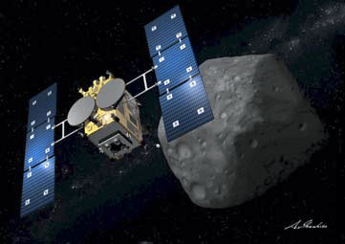
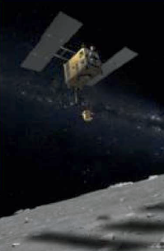
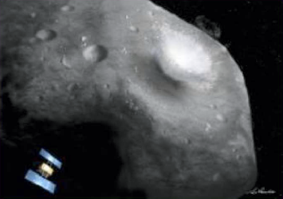

HAYABUSA-2 (3/5)
Mission Outline
Arrival at 1999 JU3
Launch
June 2018
Dec.2014 (or 2015)
HAYABUSA-2 observes 1999 U3,
releases small rovers and a lander,
and executes multiple samplings
Earth return
Dec.2020
New experiments
2019
HAYABUSA2
carries an
impactor
Departure
Dec.2019
The impactor collides with 1999 JU3
Samples not weathered by cosmic radiation will be collected from a newly created crater
Reproduced from
“The Hayabusa2 Mission of JAXA”
COSPAR Planetary Protection Colloquium 2012
Alpbach, Austria, 31 May 2012
Notes:
Mars Exploration with Landers and Orbiters Synergy (MELOS) is currently entertained in Japan Aerospace Exploration Agency (JAXA) in collaboration with a large number of planetary science groups over Japan.
As its name suggests, the MELOS mission is designed as a conglomerate mission, in which orbiters, landers, rovers, and/or airplanes are used for aeronomical, meteorological, and geoscientific researches as well as life search to reveal why Mars is now in red, that is, the fate of ancient water and carbon dioxide on the course of Martian history.
In the mission scenario, the landers and the orbiters are transported to Mars and initially inserted into an extended elliptic orbit altogether, then the landers are transferred into the atmospheric entry orbit by using the orbiter as the entry service module, after which the orbiters are maneuvered to their respective final orbit. Such a mission scenario has great potential for a variety of probe vehicles incorporated into the MELOS mission. In this article, as one of the candidate subsystems for the MELOS mission, a Mars Aeroflyby Sample Collection (MASC) system using the aeroassist orbit transfer (AOT) technologies is proposed.

Slide 6
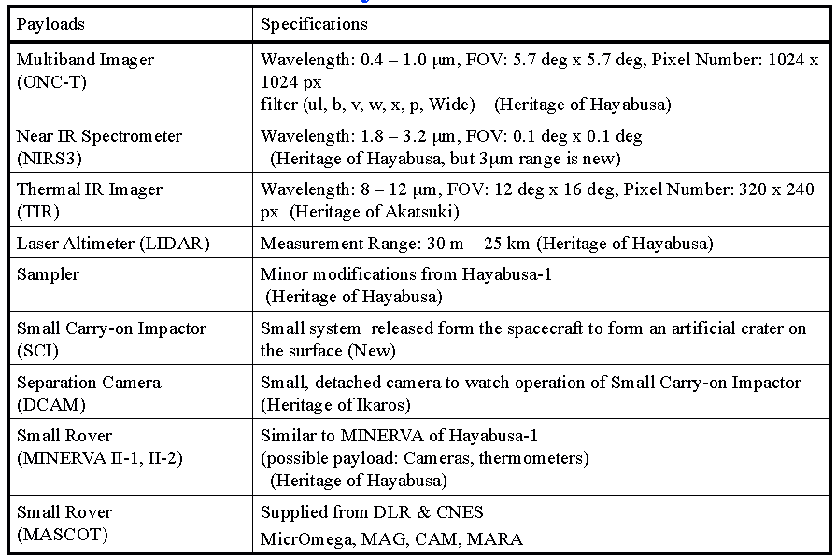
HAYABUSA-2 (4/5)
Mission instruments
Taken from
“The Hayabusa2 Mission of JAXA”
COSPAR Planetary Protection Colloquium 2012
Alpbach, Austria, 31 May 2012
Notes:
Mars Exploration with Landers and Orbiters Synergy (MELOS) is currently entertained in Japan Aerospace Exploration Agency (JAXA) in collaboration with a large number of planetary science groups over Japan.
As its name suggests, the MELOS mission is designed as a conglomerate mission, in which orbiters, landers, rovers, and/or airplanes are used for aeronomical, meteorological, and geoscientific researches as well as life search to reveal why Mars is now in red, that is, the fate of ancient water and carbon dioxide on the course of Martian history.
In the mission scenario, the landers and the orbiters are transported to Mars and initially inserted into an extended elliptic orbit altogether, then the landers are transferred into the atmospheric entry orbit by using the orbiter as the entry service module, after which the orbiters are maneuvered to their respective final orbit. Such a mission scenario has great potential for a variety of probe vehicles incorporated into the MELOS mission. In this article, as one of the candidate subsystems for the MELOS mission, a Mars Aeroflyby Sample Collection (MASC) system using the aeroassist orbit transfer (AOT) technologies is proposed.

Slide 7
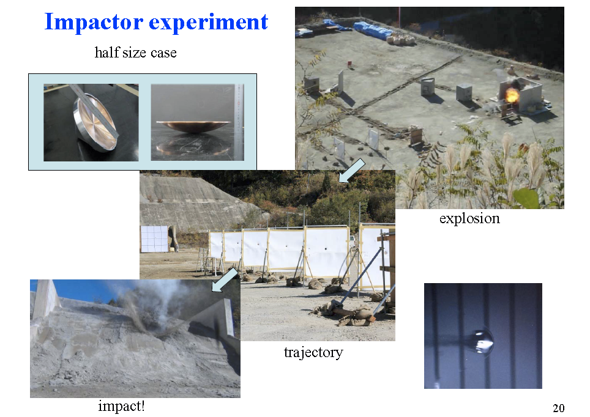
HAYABUSA-2 (5/5)
Current Status
EM test results
Date | Events
May 2011 | Phase-B started
Jul. 2011 | Phase-C started
Mar. 2012 | CDR completed
Present | Phase-D Manufacture is going on
Jan. 2013-Apr. 2013 | 1st I/F test will be done
Oct. 2013- Sep. 2014 | FM test will be conducted
Dec. 2014 | Phase-E / Launch
Dec. 2015 | Earth swing-by
Jun. 2018 | Arrival at 1999 JU3
Dec. 2019 | Departure from 1999 JU3
Dec. 2020 | Return to earth
Taken from
“The Hayabusa2 Mission of JAXA”
COSPAR Planetary Protection Colloquium 2012
Alpbach, Austria, 31 May 2012
Notes:
Mars Exploration with Landers and Orbiters Synergy (MELOS) is currently entertained in Japan Aerospace Exploration Agency (JAXA) in collaboration with a large number of planetary science groups over Japan.
As its name suggests, the MELOS mission is designed as a conglomerate mission, in which orbiters, landers, rovers, and/or airplanes are used for aeronomical, meteorological, and geoscientific researches as well as life search to reveal why Mars is now in red, that is, the fate of ancient water and carbon dioxide on the course of Martian history.
In the mission scenario, the landers and the orbiters are transported to Mars and initially inserted into an extended elliptic orbit altogether, then the landers are transferred into the atmospheric entry orbit by using the orbiter as the entry service module, after which the orbiters are maneuvered to their respective final orbit. Such a mission scenario has great potential for a variety of probe vehicles incorporated into the MELOS mission. In this article, as one of the candidate subsystems for the MELOS mission, a Mars Aeroflyby Sample Collection (MASC) system using the aeroassist orbit transfer (AOT) technologies is proposed.

Slide 8
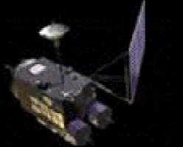
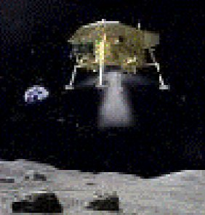
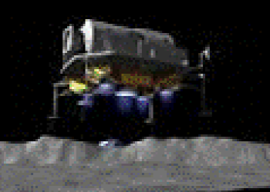
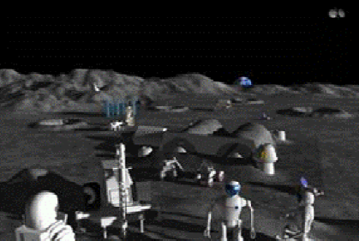
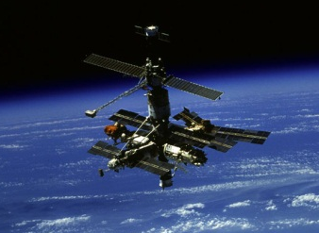
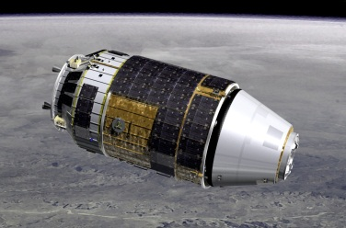
SELENE-2 (1/4)
Lunar exploration strategy proposed at JAXA
  Robotic lunar exploration
  Human lunar exploration
07 | 08 | 09 | 10 | 11 | 12 | 13 | 14 | 15 | 16 | 17 | 18 | 19 | 20 | 21 | 22 | 23 | 24 | 25 | … future
KAGUYA
SELENE-2
SELENE-X
KAGUYA (SELENE) :
Orbiter for global remote sensing
SELENE-2 :
Lander for in-situ observation
SELENE-X :
Next generation Landing mission
Science exploration & moon utilization by Japanese astronauts
With operation & utilization of ISS & HTV, fundamental technologies for human exploration will be gained
Reproduced from
“JAPANESE MOON LANDER SELENE-2
AS A ROBOTIC PRECURSOR MISSION”
GLEX-2012.03.1.7x12702

Slide 9
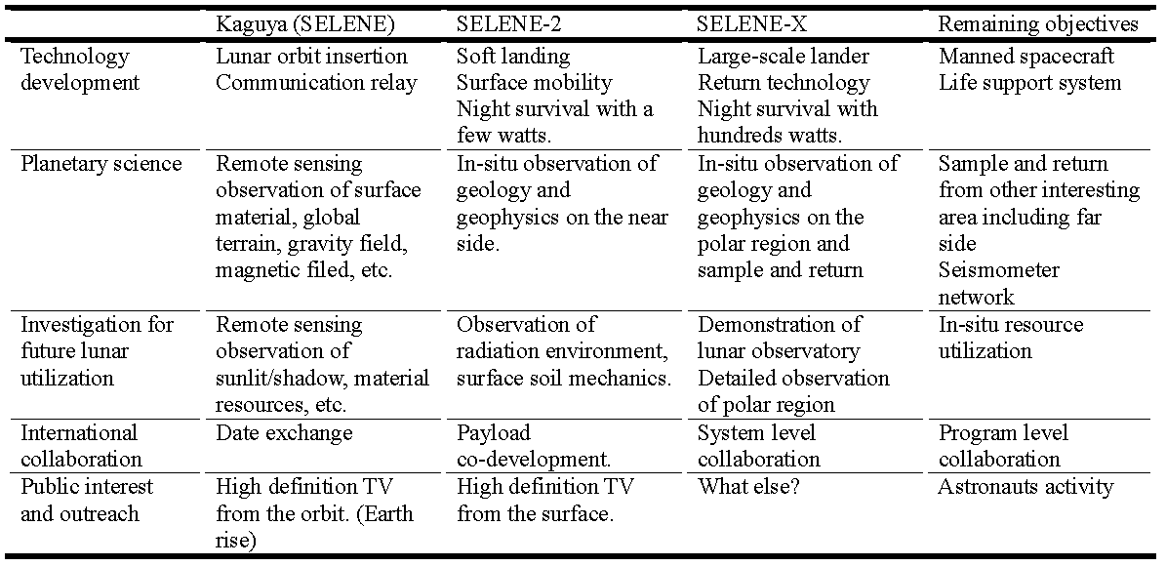
SELENE-2 (2/4)
Purpose of SELENE-2
  Demonstration of technologies required for future planetary explorations
  Scientific research and utilizablity examination by in-situ sensing
  International contribution & collaboration
Taken from
“JAPANESE MOON LANDER SELENE-2
AS A ROBOTIC PRECURSOR MISSION”
GLEX-2012.03.1.7x12702

Slide 10
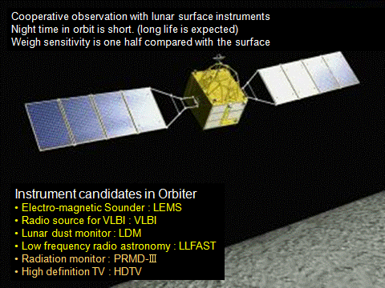
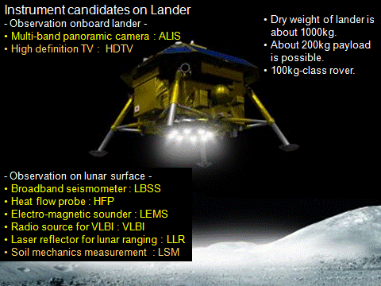
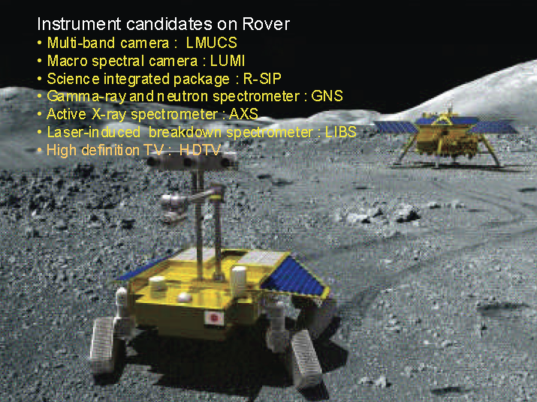
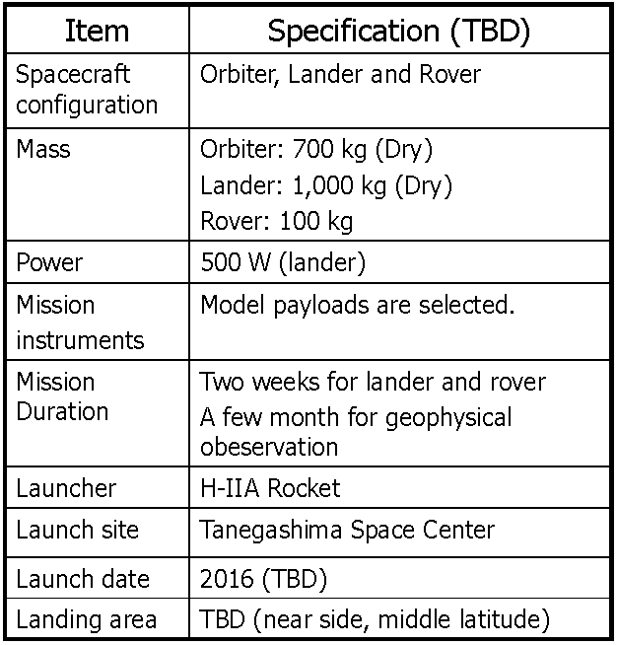
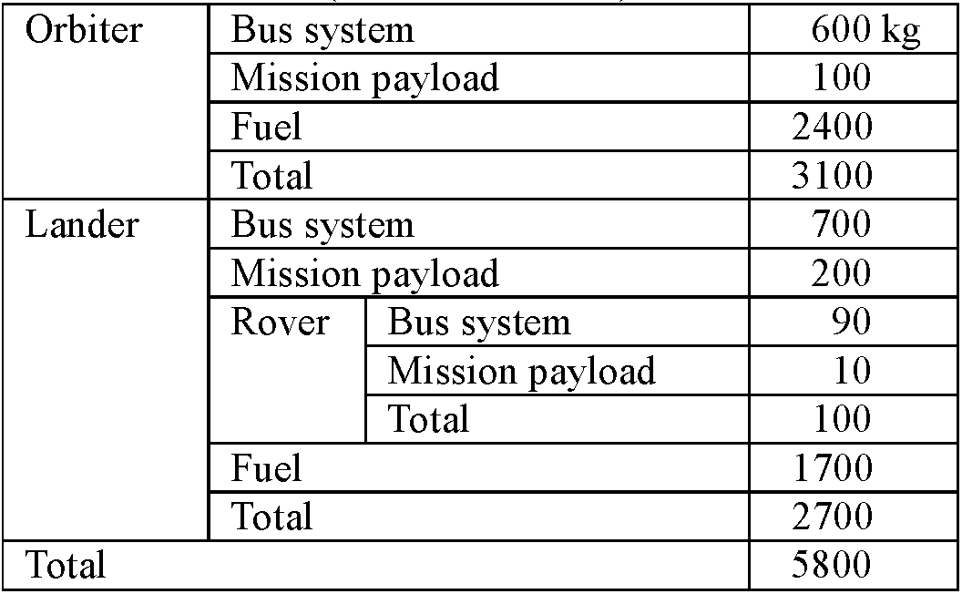
SELENE-2 (3/4)
Taken from
“JAPANESE MOON LANDER SELENE-2
AS A ROBOTIC PRECURSOR MISSION”
GLEX-2012.03.1.7x12702
System configuration
2017 (TBD)

Slide 11
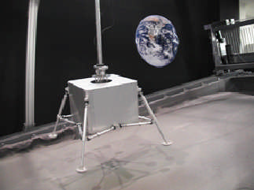
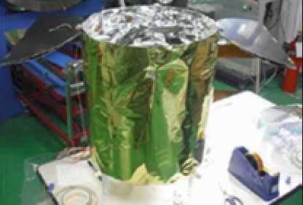
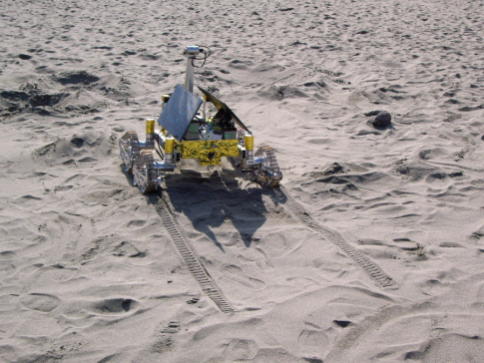
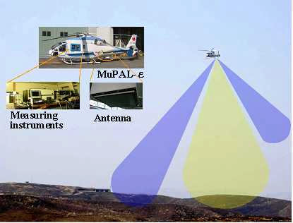
SELENE-2 (4/4)
Current status
  Proposed schedule
  Frontloading studies
Date | Events
Jun. 2007 | MDR completed Phase-A started
Sep. 2010 | ΔMDR completed
Present | Frontloading studies are going on
Aug. 2012 | SSR
Oct. 2012 | RFP
May 2013 | SDR
Apr. 2013 | Phase-B starts
2017 | Launch
Drop test of landing legs
A prototype of nigh
survival unit
Field test of a rover in Nakatajima Beach, Japan
Field test of a BBM landing radar over Mt. Aso, Japan
Reproduced from
“JAPANESE MOON LANDER SELENE-2
AS A ROBOTIC PRECURSOR MISSION”
GLEX-2012.03.1.7x12702

Slide 12
MELOS (1/4)
MELOS = Mars Exploration with Lander-Orbiter Synergy
Purpose
  Science
  To answer “How is the climate of Mars determined?” “Why is the present climate of Mars as it is?” “Life on Mars?”
    The mechanism of global material recycling in the presence of dusts, water, and trace gases
    The sign of life
  Engineering
  To demonstrate technologies required for future planetary explorations
    The EDL technology for guided entry and reliable landing
    The surface exploration technology with considerable mobility
  Exploration
  To extend the area that Nipponese can reach (political purpose)

Slide 13
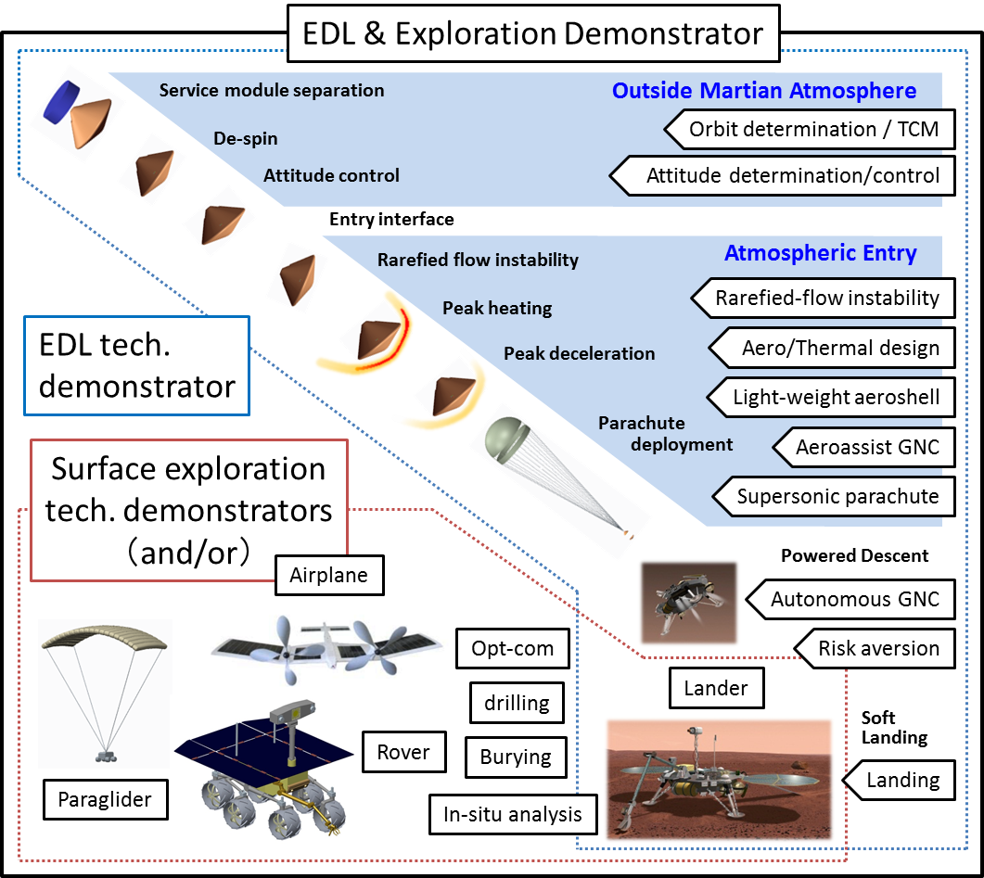
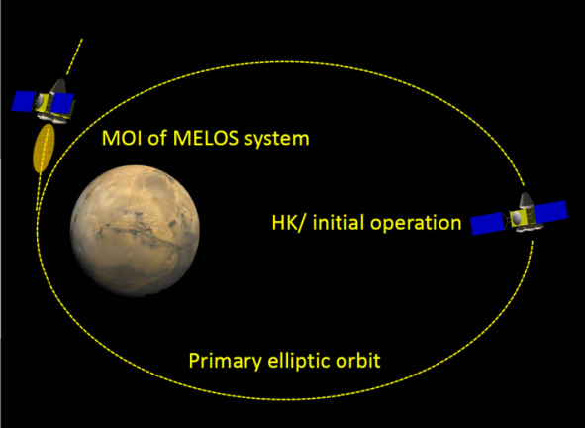
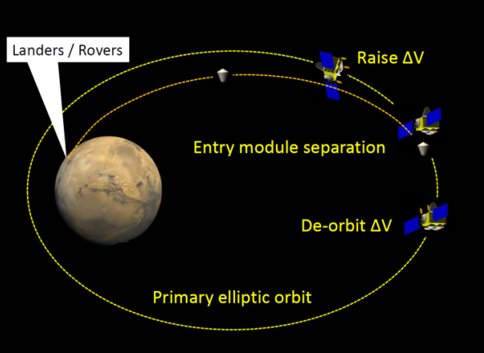
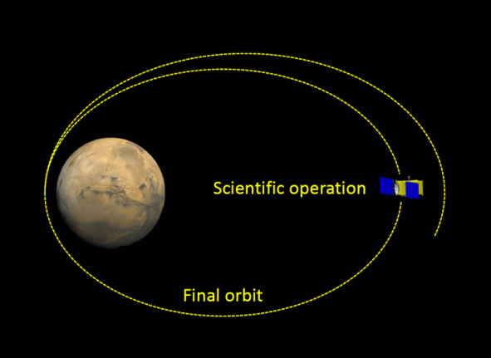
MELOS (2/4)
Fundamental mission scenario

Slide 14
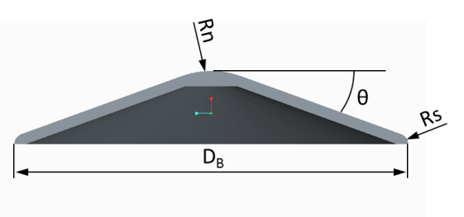
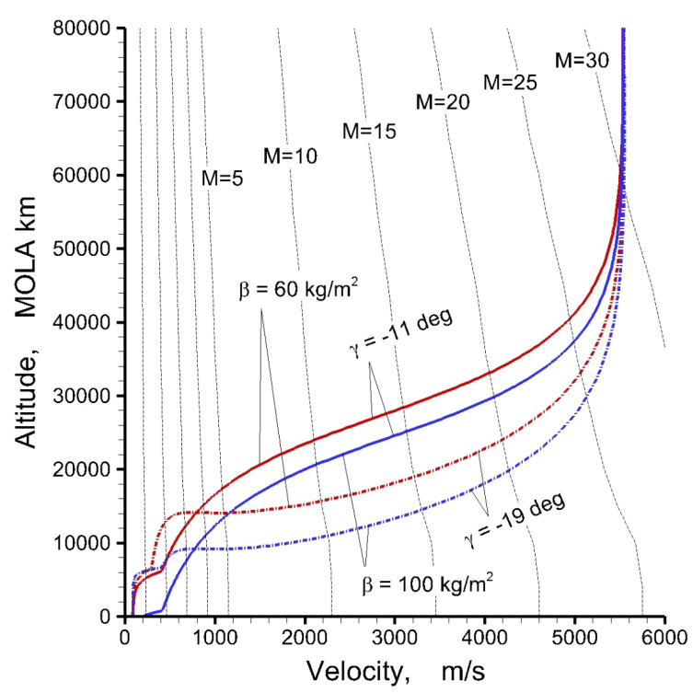
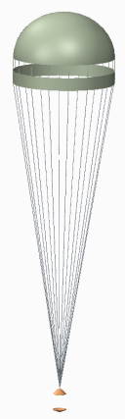
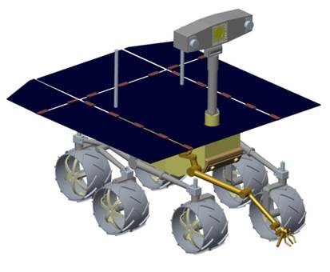
MELOS (3/4)
Conceptual design for minimum-size EDL demonstrator
  Launch in 2018, V_{inf} = 2.962 km/s
  Landing point = +2.0 MOLA altitude km / south hemisphere
  Landing subsystem = 45-kg rover only
  Mission payload = Life search & weather monitoring package (10 kg in total)
Component |  | Mass (kg)
Service module |  | 80
Parachute |  | 15
Aft-aeroshell |  | 30
Landing module |  | 113
 | Propulsion |  | 52
 | AOCS |  | 19
 | Power supply |  | 22
 | Structure |  | 20
Rover |  | 45
 | Rover bus |  | 35
 | Mission inst. |  | 10
Fore-aeroshell |  | 35
Margin |  | 35
Total |  | 353
D_{B} | 2.225 | m
β | 60 | Kg/m²
γ | -19 | ⁰
α_{trim} | -13 | ⁰
L/D | 0.2

Slide 15
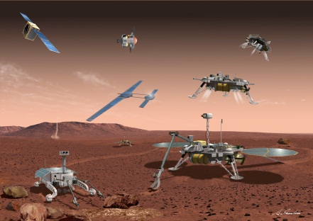
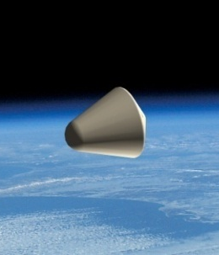
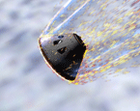
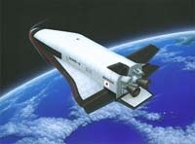
MELOS (4/4)
MELOS1
Phase A
B
C
D
E (~2022)
Demonstrators
Phase A
B
C
D
E (~2019)
MELOS2 mission
~2024
MELOS Launch (2020)
MELOS CDR (2018)
MELOS PDR (2016)
Demonstrator MDR
(2012E)
MELOS MDR (2013)
MELOS1 mission
Demonstrators at Earth/Mars
Basic research & Development
~2020
~2015
~2010
EDL demonstrator at Earth
AOT demonstrator at Mars
~2008
Front-loading phase
Light-weight aeroshell
equipped with TPS
GNC subsystem
Sample collector
Demonstrator design
TRL 8 ~ 9
Conceptual
study
Verification
in laboratory
Spin-off
Reentry system (HRV)
Reusable system
TRL 3
TRL 4 ~ 5
TRL 6 ~ 7

Slide 16

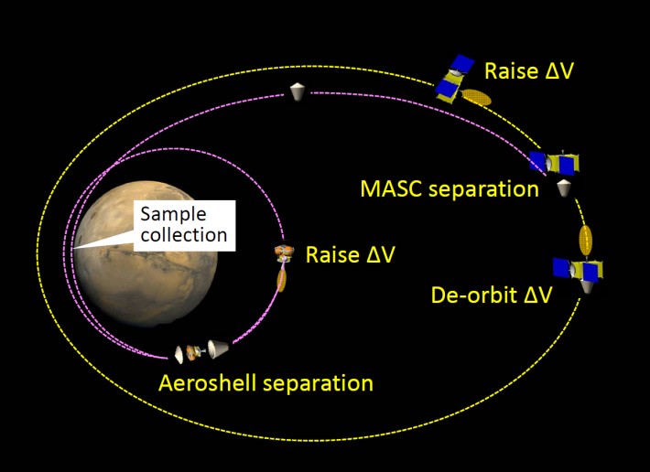
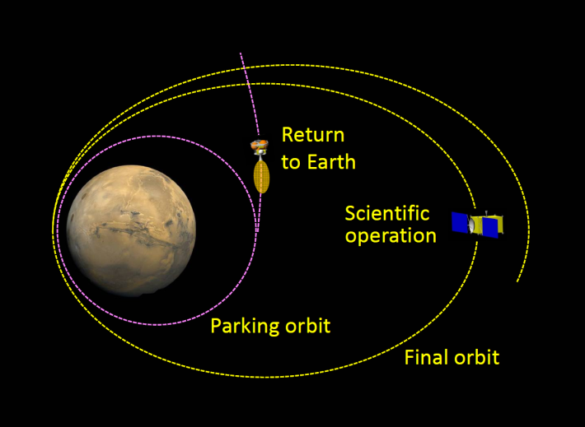
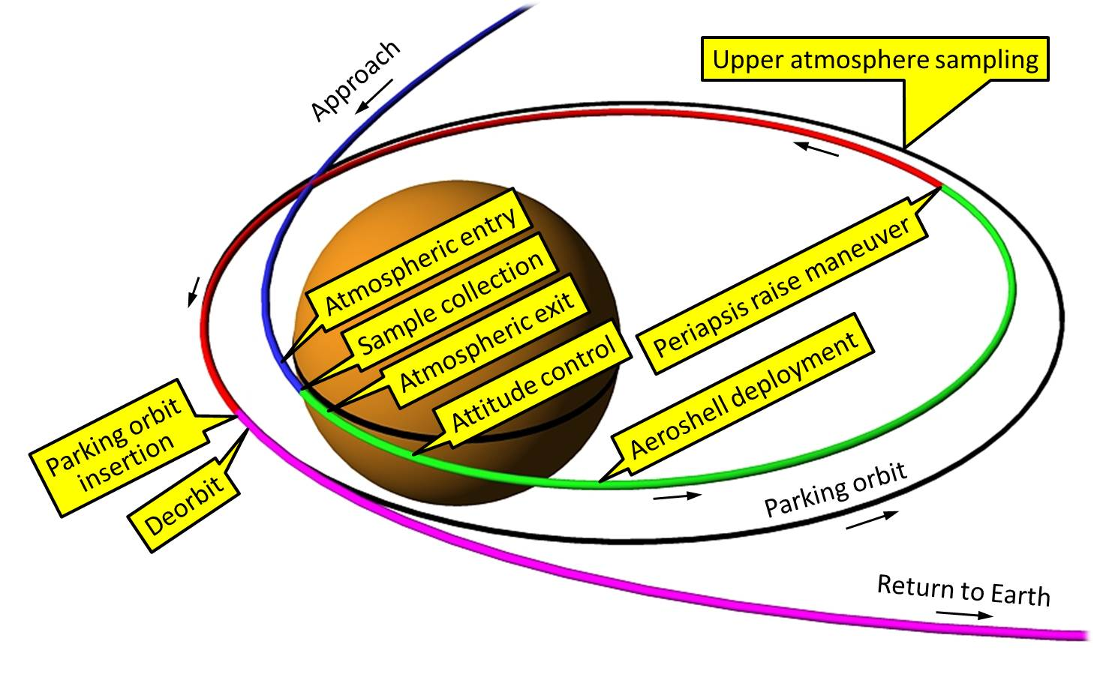
MASC (1/4)
MASC = Mars Aeroflyby Sample Collection
  Similar concept of SCIM proposed to Mars Scout Mission
  Collect Martian dust & atmosphere sample and return to earth without landing
Altitude (km) | Dust fluence for V = 4 km/s (count/cm².sec)
 | 0.5–1.5 μm | 1.5–2.5 μm | 2.5–3.5 μm | 1–10 μm
45 | 0.05 | 0.04 | 0.02 | 0.23
40 | 4 | 3 | 1.4 | 16
35 | 56 | 48 | 23 | 252
30 | 367 | 312 | 148 | 1650
25 | 1331 | 1129 | 536 | 5984
20 | 3526 | 2991 | 1420 | 15849

Slide 17
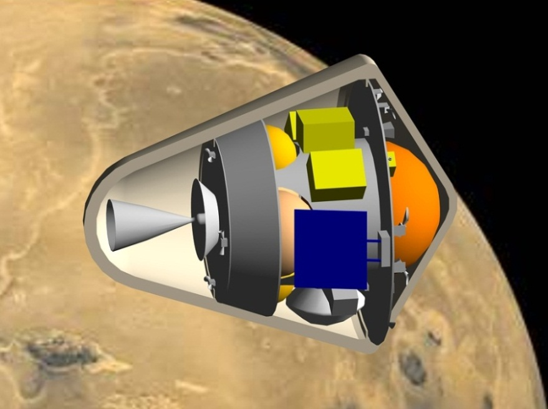
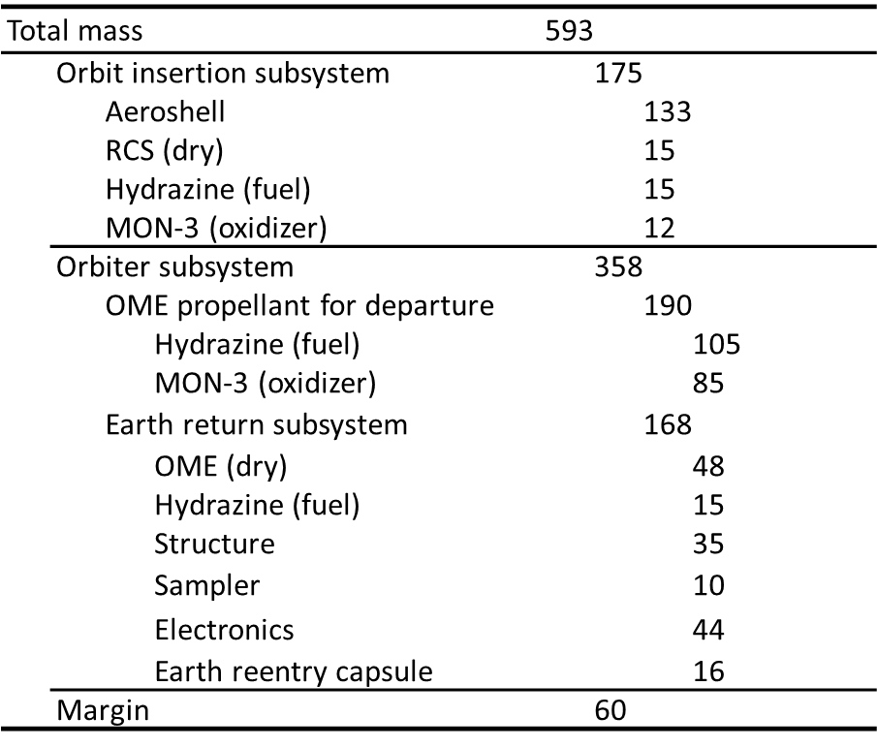
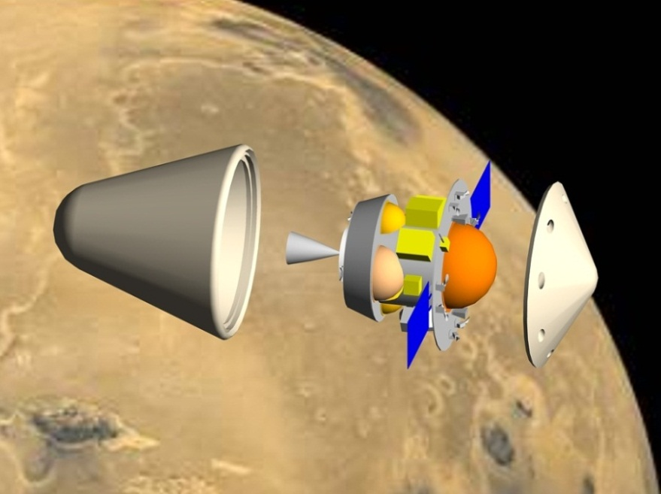
MASC (2/4)
Conceptual system design
  Conducted based on the latest status of subsystem development, and on heritages of HAYABUSA sample return system
  Further reduction of system mass may be realized by introducing new instruments

Slide 18
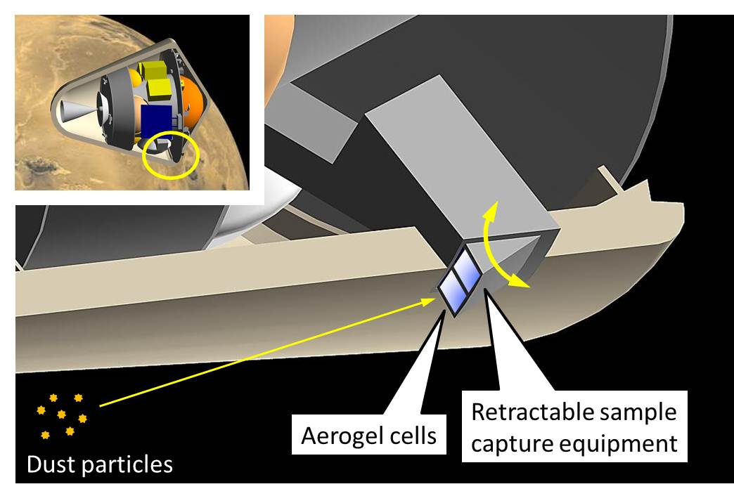
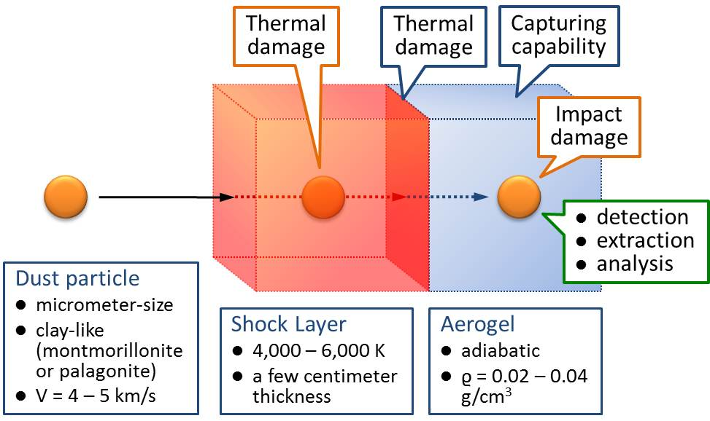
MASC (3/4)
Dust Sampler Design
  Retractable samplers (currently 2) are exposed for a few seconds
  Samplers are located near aeroshell base to reduce heat transfer rate
  Silica aerogel is used for capturing sample particles (like STARDUST)
  Aerogel cells are transported to the reentry capsule inside MASC
Key issues
  Damages inflicted on dust particles by high-temperature shock layer
  Damages inflicted on aerogel exposed to high-temperature shock layer
  Dust capturing capabilities of aerogel
  damages inflicted on dust particles by impingement
  capabilities of detecting & extracting dust samples stuck in the aerogel

Slide 19
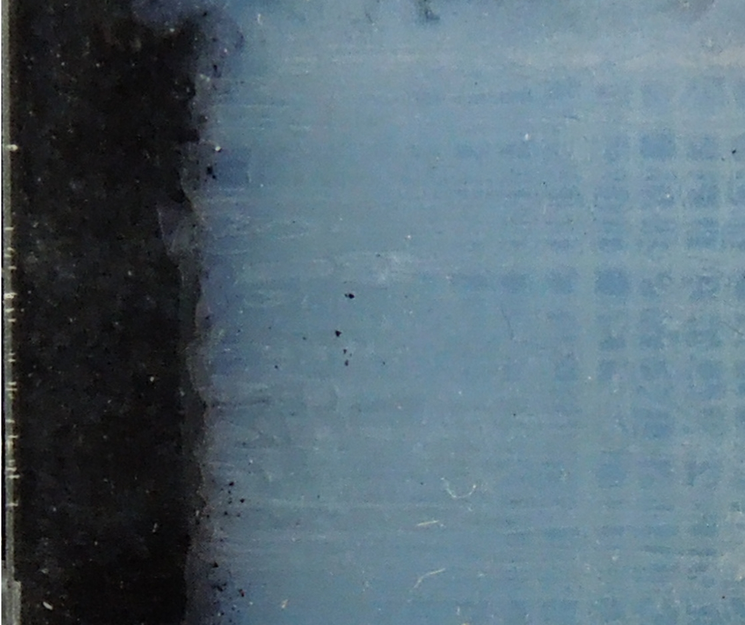
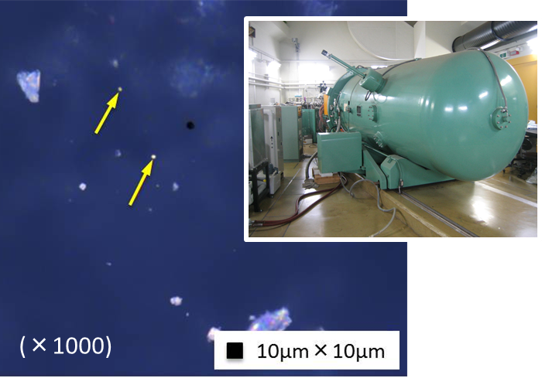
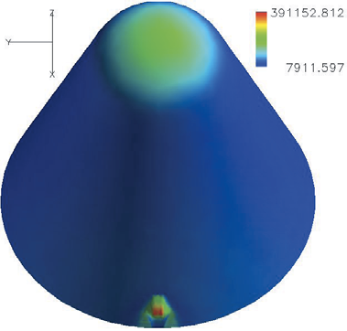
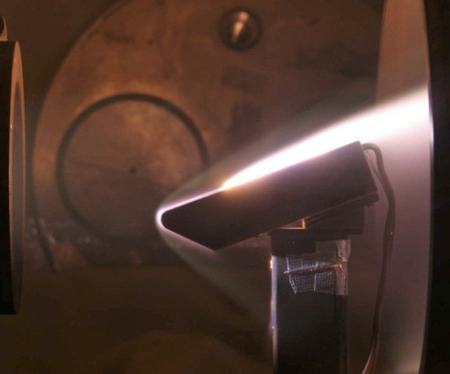
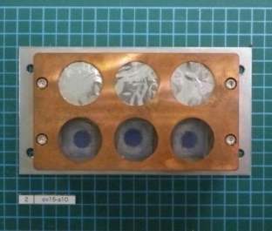



MASC (4/4)
Current status of frontloading studies
  Development of Non-Ablative Light-weight Aeroshell (NALT)
  Detailed estimation of flight environments
  Bus design update
  Development of dust sampler
    Trajectory & heat transfer analysis of sample dust particles
    Arcjet heating test campaigns
    Dust capturing test
    Detection / extraction / analysis capability test
CA-SA 2-layered aerogel
for higher heat-resistance
VdG dust capture tests
Trajectory analysis of particles
Optimization of collector location
by means of CFD
Before test
Micro X-ray CT for sample extraction
After test
SA
CA

Slide 20


Mars Aerocapture Demonstrator (1/3)
Purpose
  Proposed as a low-cost, quickly-developed, small-sized demonstration mission
  Demonstration of aerocapture technique
    Accurate orbit determination & TCM
    Aeroassist guidance & navigation
    Ultra-light-weight aeroshell equipped with TPS
Mission overview (case study)
  A small-sized simple bus system
    Launched as a piggyback of an appropriate main spacecraft for a deep-space mission
    Total wet mass = 240 kg at earth departure
    Orbit adjustment by earth swingbys
    Mars arrival with V_{inf} ~ 4 km/s
  Aerocapture subsystem
    Aeroshell weight ~ 40 kg
    Post aerocapture ΔV < 100 m/s
    Aerocapture corridor : Δγ < 0.2⁰
    Lifting aeroshell with L/D ~ 0.2
    Final orbit apoapsis alt. = 300 km ~ 30 Rm

Slide 21






Mars Aerocapture Demonstrator (2/3)
Feasibility assessment
  Aerocapture corridors
  Design of aeroshell
  System design
  Operation planning
  Verification

Slide 22









Mars Aerocapture Demonstrator (3/3)
Frontloading R & D (common activities for Mars missions)
  Ultra-light-weight aeroshell
    Light-weight ablator (ρ ~ 0.3 g/cc)
    Non-ablative Lightweight TPS (NALT)
  Improvement of accuracy in predicting flight environments
    3D CFD & verification by experiments
    VUV to IR radiation model

Slide 23



Venus Balloon (1/2)
Purpose
  Proposed as a low-cost, quickly-developed, small-sized demonstration mission
  Scientific aspect : in-situ sensing of Venus
    Long-term observation under clouds (alt. 35-40 km < VEGAs flight altitudes)
    Mechanism of strong equatorial winds (super-rotation), N-S circulation, observation of aerosol…
  Engineering aspect
    High temperature electronics, planetary balloon technology, entry probe technology, VLBI,…
Mission overview
  A small-sized simple bus system
    Total mass = 160 kg at arrival
    Direct entry of a 35-kg capsule (V~11km/s)
    Bus system flyby (or VOI by aerocapture)
  A long-term super-pressure balloon
    Lifetime > 30 days
    Inflated & maintained by using water vapor pressure
    Total mass = 10 kg

Slide 24



Venus Balloon (2/2)
Current status of feasibility assessment
  Conceptual design of entry system
    Radiation-coupled flowfield analysis (2006)
    Trajectory-based TPS design (2007)
  Conceptual study of VOI by aerocapture
    Drag-modulation aerocapture sub-system
    analysis (2008)
  Balloon inflation demonstration (2007)
    Vertical low-speed hi-temp. WT (~150⁰C)
    0.16x1.88 m test balloons
Components |  | Weight (kg)
TPS | Nose Side Aft body | 6.3 5.8 5.1
Structure |  | 3.2
Mortar |  | 0.7
Pilot chute |  | 0.4
Main chute |  | 1.1
Bus electronics |  | 2.0
Battery |  | 0.4
Payload | Balloon Gondola | 7.8 2.2
Total |  | 35.0

Slide 25
Summary
An overview of Japan’s planetary probe mission planning is presented from a scheduled mission (HAYABUSA-2) to concept-level researches
In the next mid-term program, JSPEC concentrates its effort on success of HAYABUSA-2, and initiation of SELENE-2 mission
In the preliminary feasibility studies, technically challenging missions such as Mars aerocapture, MASC, and Venus balloon have been entertained
Because of limited budget and resources, JAXA is looking for chances for international collaboration/cooperation for deep space missions

