Slide 1
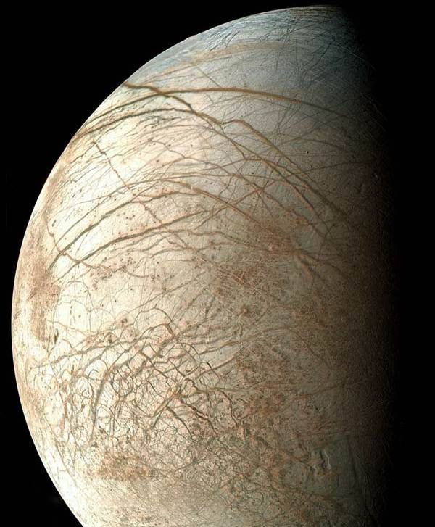
An Astrobiology Payload Complement for a Europa Penetrator
Rob Gowen, MSSL/UCL
Tom Kennedy, Herve Lamouroux, Andrew Griffiths
Sanjay Vijendran - ESTEC
Lester Waugh – Astrium EADS
Lewis Dartnell – UCL
Simon Sheridan – OU
Jose Rodriguez-Manfredi – CAB, Madrid, Spain
Jeremy Fielding – Rapid Space Technologies

Slide 2
Contents
Introduction
Model Payload Selection
E-PAC Design

Slide 3
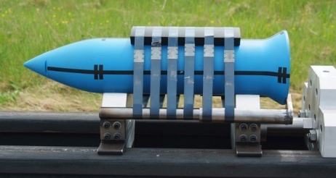
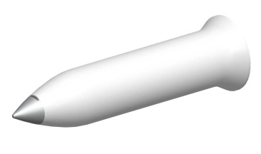
Penetrator Consortium

Slide 4
Background to Current Study
2 ESA studies, special provision to UK
Astrium prime, MSSL/UCL, QinetiQ, and now Rapid SpaceTechnologies
Penetrators to Jovian Moons, and Mars
Climbing the TRL ladder
2010 Penetrator Phase-I Study - Delivery system and penetrator
2012 Penetrator Phase-II Study - Astrobiology Payload Complement - Updates to penetrator and delivery system - Small and full scale impact testing
Phase-1 study :
Europa Penetrator ~11 kg
Descent Module ~62 kg

Slide 5
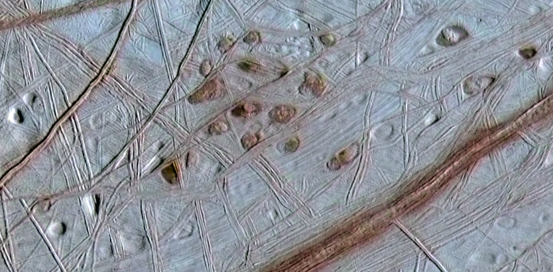
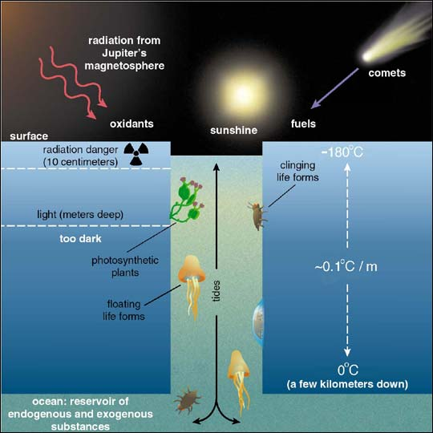
Europa
Best candidate for life in solar system ?
Water ice surface thin crust with many cracks, geologically young.
Evidence of upwelled material from beneath
Believe warm water subsurface ocean protected from radiation
Nutrients supply from above or below.
→ Observe upwelled material on surface for life, and habitability conditions of water.

Slide 6
MODEL PAYLOAD SELECTION

Slide 7
Science Requirements
In-situ investigations can provide much more capability than from orbit. (close-up, provenance, sample)
Identified 3 main science categories :-
Astrobiology Science | Score range
Habitability | [0-5]
Astrobiological Materials and Processes | [0-8]
Lifeforms | [0-10]

Slide 8
(a) Habitability (13 areas) | A | P | PS | Instrument Types
Radiation environment | 5 | 3 | 2 | X-ray, ɣ-ray , alpha, electron, proton, neutron and dosimeter sensors. accelerometers
Heat flux | 5 | 1 | 1 | thermometers, tiltmeter
Physico-chemical properties of melted water ice | 5 | 10 | 5 | pH, redox, conductivity
Habitat location and extent | 5 | 5 | 3 | seismometer, magnetometer, radio beacon, geophysical tiltmeter, accelerometers
Planetary body core | 5 | 5 | 3 | seismometer, radio beacon
Seismic activity | 5 | 10 | 5 | seismometer, geophone, geophysical tiltmeter
Magnetic field | 5 | 10 | 5 | magnetometer
Surface morphology | 5 | 10 | 5 | descent camera, landed camera
Temperature | 5 | 5 | 3 | thermometer
Surficial thermal properties | 4 | 3 | 1 | thermometers
Surficial light levels | 3 | 1 | 1 | photometer
Surficial electrical properties | 4 | 5 | 2 | permittivity, conductivity probes
Surficial mechanical properties | 3 | 5 | 2 | accelerometer, penetration probes
Astrobiological Materials and Processes (4 areas)
Mineral composition | 5 | 10 | 5 | microscope, spectrometers, descent and landed cameras
Elemental composition | 7 | 10 | 7 | Raman, IR, visible, XRS, APXS, LIBS, GRS and mass spectrometer, descent and landed camera
Organic and metabolic compounds | 8 | 10 | 8 | Raman, IR, visible, XRS, and mass spectrometer, thermogravimeter, ɣ-ray sensor, descent and landed cameras
Isotopes | 8 | 10 | 8 | isotope mass spectrometer, tunable laser diode spectrometer
(c) Lifeforms (2 areas)
Cells | 10 | 10 | 10 | microscope, UV fluorescence imaging, spectrometers
Higher life forms | 10 | 10 | 10 | microscope, UV fluorescence imaging, spectrometers, descent and landed cameras
Maximum score = | 107 |  | 85 | (80% of maximum achievable with penetrator)
Notes:
A large number of instrument types are applicable for a penetrator, and can achieve up to an estimated 80% of the total possible science return.
Access to the external planetary environment or material is required to achieve most astrobiological science (shaded areas)
Many instrument types can investigate multiple science areas.
Synergies exist between instruments to achieve maximum science, or confirm results.
Heat flux and surficial light measurements present serious difficulties in returning valuable science from a penetrator platform, and radiation monitoring appears particularly constrained.
In the event of non-detection of astrobiological signatures, a strong geophysical return could be achieved.

Slide 9
Technical Requirements
4 kg E-PAC mass limit To include all instruments and sample acquisition mechanisms, To include 50% maturity margin and 20% system margin. => 2.2 kg without margin.
Technology maturity -> to be able to be ready for a flight demonstration in the next decade (2020’s).
Survive impact into Europan ice at 300 m/s
Provide external access from penetrator
Power

Slide 10
Candidate Instruments
Canvassed 35 institutes as widely across ESA member states as possible + from existing penetrator consortium
Performed full science and technical assessments on all responses, and on promising existing instruments known to consortium
Plus, performed abbreviated considerations on all instruments already known to consortium
Instrument | Acronym | Lead Institute
Microseismometer | MSEIS | IC-1
Magnetometer | MAG | IC-2
Habitability Package | HCP | CAB
Biochemistry Mass Spectrometer | BMS | OU
Thermogravimeter | TBS | INAF
Sample Imager | SI | MSSL
Radio Science | PERA | ROB
Raman | HCRS | TNO
Main candidate instruments

Slide 11
Science Assessment of Candidate Instruments
Astrobiology Science Investigations | Pen. Science value | MSEIS |  | MAG |  | HCP |  | BMS |  | TBS |  | SI |  | PERA |  | HCRS
 |  | capability | score | capability | score | capability | score | capability | score | capability | score | capability | score | capability | score | capability | score
(a) Habitability (max science score 5)
Radiation environment | 3
Heat flux | 1
Physico-chemical properties of melted water ice | 5 |  |  |  |  | 10 | 39
Habitat location and extent | 3 | 7 | 5 | 3 | 2 |  |  |  |  |  |  |  |  | 5 | 3
Planetary body core | 3 | 5 | 3 |  |  |  |  |  |  |  |  |  |  | 5 | 3
Seismic activity | 5 | 10 | 13
Magnetic field | 5 |  |  | 5 | 7
Surface morphology | 5
Temperature | 3
Surficial thermal properties | 2
Surficial light levels | 1
Surficial electrical properties | 2
Surficial mechanical properties | 2
(b) Astrobiological Materials and Processes (max science score 8)
Mineral composition | 5 |  |  |  |  |  |  | 5 | 6 | 3 | 4 | 8 | 10
Elemental composition | 7 |  |  |  |  |  |  | 4 | 7 |  |  | 2 | 4
Organic and metabolic compounds | 8 |  |  |  |  |  |  | 7 | 14 | 8 | 16 | 5 | 10 |  |  | 5 | 10
Isotopes | 8 |  |  |  |  |  |  | 3 | 6
(c) Lifeforms (max science score 10)
Cells | 10 |  |  |  |  |  |  | 2 | 5 | 2 | 5 | 3 | 8
Higher life forms | 10 |  |  |  |  |  |  | 3 | 8 | 3 | 8 | 6 | 15
Total instrument science score = |  |  | 21 |  | 9 |  | 39 |  | 46 |  | 33 |  | 46 |  | 7 |  | 10
Notes:
Unshaded areas do not require external access/sample.
Can see that instruments can contribute to multiple science areas.

Slide 12
Technical Assessment of Candidate Instruments
 | Driver/Instrument | MSEIS | MAG | HCP | BMS | TBS | SI | PERA | HCRS
2 | Instrument description | -5 | 0 | -10 | -5 | -5 | -10 | -10 | -10
3 | Access to external environment/sample | 0 | 0 | -10 | -10 | -10 | -10 | 0 | -10
4 | External equipment | 0 | 0 | -10 | -10 | 0 | 0 | -10 | -5
5 | Accommodation | -3 | -3 | -5 | -5 | -3 | -3 | -5 | -5
6 | Mounting requirements | -3 | -3 | -3 | 0 | 0 | -3 | -3 | -3
7 | Ruggedness | -5 | -5 | -10 | -5 | -5 | -10 | -10 | -10
8 | Operational lifetime | -5 | -5 | -3 | -3 | -5 | -3 | -5 | -3
9 | Instrument operations | -5 | -5 | -10 | -3 | -3 | -3 | -3 | -3
10 | Mass | -3 | -3 | -3 | -5 | -3 | -3 | -5 | -5
11 | Power/Energy | -5 | -5 | -3 | -5 | -5 | -3 | -10 | -5
12 | Telemetry | -10 | -5 | -3 | -3 | -3 | -5 | 0 | -5
13 | Commanding | -5 | 0 | -3 | 0 | 0 | 0 | 0 | 0
14 | Thermal environment | -5 | -5 | -10 | -5 | -5 | -10 | -5 | -3
15 | Electrical environment | -5 | -10 | -5 | -5 | -5 | -3 | -3 | -3
16 | Radiation environment | -5 | -5 | -3 | -3 | -3 | -3 | -3 | -10
17 | Planetary protection | -5 | -5 | -5 | -3 | -3 | -3 | -10 | -10
18 | Instrument heritage | -3 | -3 | -5 | -5 | -5 | -5 | -10 | -10
19 | Current TRL | -3 | -3 | -5 | -3 | -5 | -10 | -10 | -10
20 | Developments required | -5 | -5 | -5 | -5 | -5 | -10 | -10 | -10
Average scores
Average Technical Score |  | -4 | -4 | -6 | -4 | -4 | -5 | -6 | -6
Average Critical Drivers Score |  | -4 | -4 | -6 | -6 | -6 | -8 | -8 | -8
Converted scores [C=10+average scores] where 10=best.
Technical Score [0,10] |  | 6 | 6 | 4 | 6 | 6 | 5 | 4 | 4
Critical Drivers Score [0,10] |  | 7 | 7 | 4 | 5 | 5 | 2 | 3 | 2
Notes:
Not much difference between overall and critical drivers scores (exception is SI)
These assessments are preliminary.
They depend on critical aspects such as impact survival which has not yet been demonstrated for most of the instruments, and detailed E-PAC assessments.
It is recommended that these assessments be updated when a mission opportunity becomes clear.

Slide 13
Model Payload Selection
E-PAC System and Instrument Requirements
Candidate Instruments
Science capability
Candidate Instruments
Technical capability
E-PAC Model Payload Options
Proposed E-PAC Model Payload

Slide 14
Priority Ordered Candidate Instruments
Priority | Instrument |  | Habitability | Materials and Processes | Lifeforms | Total science score | Technical score | Combined Sci+tech score
1 | Mass spectrometer | BMS |  | 8.4 | 3.1 | 11.6 | 4.5 | 16.1
2 | Habitability package | HCP | 9.8 |  |  | 9.8 | 4.8 | 14.6
3 | Sample imager | SI |  | 5.6 | 5.6 | 11.2 | 2.3 | 13.5
4 | Thermogravimeter | TBS |  | 5.0 | 3.1 | 8.1 | 4.5 | 12.6
5 | Microseismometer | MSEIS | 5.3 |  |  | 5.3 | 6.5 | 11.8
6 | Descent Camera (Pen) |  | 3.3 | 3.8 | 1.9 | 8.9 |  | 8.9
7 | Magnetometer | MAG | 2.1 |  |  | 2.1 | 6.5 | 8.6
8 | Descent Camera (PDS) |  | 2.3 | 2.5 | 0.6 | 5.4 |  | 5.4
9 | Radio Beacon | PERA | 1.7 |  |  | 1.7 | 2.5 | 4.2
10 | Raman Spectrometer | HCRS |  | 2.5 |  | 2.5 | 1.7 | 4.2
11 | Thermal probes |  | 3.5 |  |  | 3.5 |  | 3.5
13 | Landed camera |  | 0.2 | 1.3 | 0.6 | 2.1 |  | 2.1
14 | Accelerometers |  | 1.7 |  |  | 1.7 |  | 1.7
12 | Radiation monitor |  | 1.3 |  |  | 1.3 |  | 1.3
15 | Electrical instrument |  | 1.3 |  |  | 1.3 |  | 1.3
16 | Photometer |  | 0.8 |  |  | 0.8 |  | 0.8
 |  | Maximum penetrator science score = |  |  |  | 77.4
Notes:
Top instrument in each category ->Habitability, Materials and Lifeforms are top of list.
Instruments without questionnaire responses or who did not take part in TDA activities are unshaded.
Combined score = Science score + Technical score.

Slide 15
Recommended E-PAC Model Payload
Instrument | Acronym | Habitat | Materials | Lifeforms | science score | Mass (g) | Cumulative mass (g) (including margins)
(a) Mounted on PDS
Descent camera |  | H_{surf} | M | L | 5.4 | 160 | 288
(b) Mounted within E-PAC (require access to sample, and short lifetime -> hours)
Sample Handling | SHS |  |  |  |  | 785 | 1413
Mass Spectrometer | BMS |  | M | L | 11.6 | 1163 | 3506
Sample Imager | SI |  | M | L | 11.3 | 87 | 3663
Habitability Package | HCP | H_{mat} |  |  | 9.8 | 120 | 3879
(c) Mounted in Penetrator (do not require sample access, and long lifetime -> ~week)
Microseismometer | MSEIS | H_{loc} |  |  | 5.3 | 300 | 540
Magnetometer | MAG | H_{oc} |  |  | 2.1 | 58 | 644
Radiation Monitor | RADM | H_{env} |  |  | 1.3 | 75 | 779
Notes:
Locate instruments external to E-PAC to reduce overall system risk to science return :-
Instruments mounded on PDS
Descent camera
Eliminates risk of total loss of science return from impact failure
Instrument mounted within Penetrator E-PAC bay
Instruments which require access to external environment (sample), and only a short operational lifetime (~hours/day).
Instruments mounted external to Penetrator E-PAC bay
Reduces thermal breach risks, due to sample acquisition process, to long lifetime instruments such as microseismometer, magnetometer and radiation monitor.
Also eliminates a single point failure mechanism if all instruments were located within a single E-PAC bay.

Slide 16
Model Payload – Science Coverage
Science Requirement | E-PAC Model Payload Instrument (items,sensitivity)
1. Assess habitability of subsurface ocean materials
chemistry, pH, redox, electrical conductivity | BMS (chemical volatile inventory to 900ºC) HCP (pH, redox, electrical conductivity)
2. Assess habitability context of surface and near surface
radiation environment | RADM (external to E-PAC)
3. Assess habitability of subsurface ocean
depth, extent, salinity/currents | MSEIS (external to E-PAC) MAG (external to E-PAC)
4. Determine chemical content of biological interest
elements, compounds, minerals and isotopes | BMS (chemicals and isotopes) (10-300 Da, sub to few ppm) SI (minerals, colour imaging to 45 µm resolution)
5. Detect morphological signs of life
Lifeform shapes, internal structures, and motions | SI (colour imaging of 10 mm image to 45 µm resolution, UV fluorescence)

Slide 17
Model Payload Selection Conclusions
Good astrobiology science coverage within 4 kg E-PAC
Enhanced science coverage if include external seismometer, radiation monitor and magnetometer (for +800g including margins)
Substantial geophysics return, even if no astrobiological presence.
Is a preliminary selection which could change. (depends on impact survivability, evolving technology, and requirements for a real mission)
Model Payload Options | Estimated Astrobiology Return | Estimated Geophysics Return
Recommended Model Payload (E-PAC only) | 45% | 34%
Recommended Model Payload (full) | 65% | 62%
Percentages compare against selection of all possible instruments considered.

Slide 18
E-PAC DESIGN

Slide 19
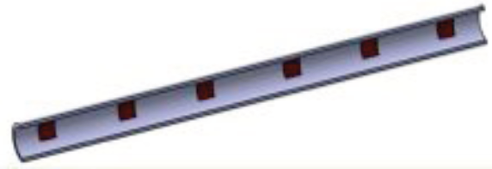
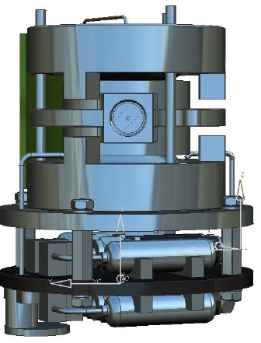
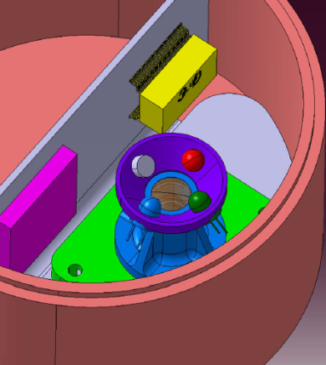
E-PAC Model Payload
HCP
Micro-sensors (electrode probes) immersed in 1 ml of melted sample water.
Instrument technology is well established on Earth.
BMS
Miniature state of the art quadrupole ion trap mass spectrometer.
Design heritage from Ptolemy instrument on Rosetta.
SI
Design heritage from Pancam instruments on Beagle-2 and developments for ExoMars.
Current design is minimum performance
HCP (CAB)
BMS (OU)
Sample Imager (SI) (MSSL)

Slide 20
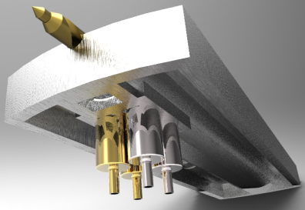
+ Sample Handling System
drill
Sample material collection mechanism
(Rapid Space Technologies)
sample containers
Sample Handling System
Sample Acquisition and Delivery System | Sample Acquisition System (SAS) (x2) (drill/auger)
 | Sample container (x4)
 | Sample container fill system (gravity/chute/brushes)
 | Sample container sealing system (pyro)
Sample Processing System
 | Sample heating system
 | Sample temperature and pressure monitoring system
 | Sample expelled gases outlet feed system
 | Sample expelled exhaust gases removal system

Slide 21
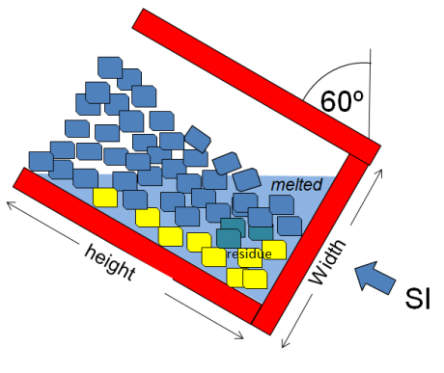
Sample Material Collection System
To cope with 60º emplacement angle.
Access materials from opposite sides of penetrator (2 drills -> provide redundancy) (at least one downhill).
Discard contaminated materials.
Avoid losing volatiles from sample by drilling process.
Sample size:
SI ≥ 0.1 ml
HCP ≥ 1.0 ml
BMS ≥ 0.1 ml
~25 mm
~10 mm
sample container (Illustrating 60º maximum implantation angle)

Slide 22
E-PAC Design
E-PAC located in ‘short life’ bay in penetrator nose
Utilises common electronics
Thermally isolated from rear of penetrator
Anticipate inductive electrical interface with rear of penetrator
Sample collection mechanisms
(2 off; offset by 180º )
Blocking plate (thermal protection)
HCP electrodes
Sample processing system
Sample containers
Sample imager
BMS

Slide 23
E-PAC Operations Overview
Image sample oven before drill through shell. (to ensure container is empty/contamination free from cruise phase or impact)
Drill though shell and discard first sample (contaminated with shell material)
Acquire a good solid sample into oven.
Image sample to confirm sample has been acquired, and obtain mineralogy and UV fluorescence images from unmodified sample.
Seal oven and heat in stages. At each heating stage :-
The evolved gases diffuse into the mass spectrometer (BMS) for chemical analysis.
The HCP is operated continuously to return pH, redox, and conductivity information.
The SI images to detect volatile grains that have been removed from sample.
Repeat for extended drill sample
Repeat for other drill samples
provide redundancy/fault tolerance

Slide 24
Sample Heating Phases in more detail…
Phase-1: Frozen sample -> SI science from unmodified sample
Phase-2: Heat to release volatiles (sublimated gases) -> science BMS,SI
Phase-3: Heating until water ice melts produces liquid sample (sealed container with pressure control) - HCP can confirm that liquid phase has been achieved and make pH, redox and conductivity measurements.
- Any high density residues will fall to bottom where they can be imaged by SI. Phase-4: Heating until water has been evaporated, leaving only a dry material residue. - HCP can detect when liquid is removed - SI can now detect removal of higher temperature volatiles.
Phase-5: Heat in presence of oxygen to burn sample residue to 900C. - SI can image remaining residues (TBC)

Slide 25
Conclusion - Next Steps
Capable E-PAC successfully designed.
Update Penetrator and Descent Module design -> close to completion ! -> next presentation
Small scale impact tests of penetrator equipment –> Oct.
Full scale impact trials into sand and ice (Europa simulant) –> next March
Thankyou
Rob Gowen: rag@mssl.ucl.ac.uk

