Slide 1
Orion Multi-Purpose Crew Vehicle Drogue Parachute
Performance
Anita Sengupta , California Institute of Technology, Jet Propulsion Laboratory, Pasadena CA
Ricardo Machin, Gary Bourland , NASA Johnson Space Center, Houston TX
Jose Laguna, Rob Sinclair , Airborne Systems Inc., Santa Ana CA
Edward White , Texas A&M University, College Station TX
Copyright 2010 California Institute of Technology. Government sponsorship acknowledged. The use of the NASA insignia is governed by JPL Rules! DocID:77692. No logos may coexist with the NASA insignia except other agency sponsor logos.

Slide 2
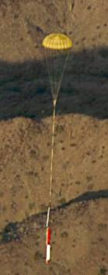
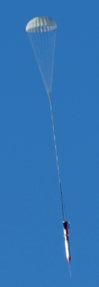
Test Program Motivation
Orion wake drogue Interaction is not well quantified wrt parachute performance
Parachute system design (textiles and trailing distance) parameters related to this are not supported by data for the CPAS configuration
Risk reduction and mass optimization could be achieved in quantification of this environment and validation of codes used in the design process
Data from a subscale test can support / optimize the full scale test design at very low cost
CFD-FSI Simulations of the CPAS parachute system are being performed to provide insight into the aerodynamics in parachutes in supersonic flow but have not been validated
Techniques developed can be leverage by future NASA parachute design and analysis efforts
Flight Tests are not performed in representative wake

Slide 3
Test Requirements and Diagnostics
Simulate flight like wake in a subscale environment (Re, Q)
Achieve geometric and construction similarity to the full-scale article
Minimize effects of wind tunnel blockage
Minimize Aerodynamic Interference
High spatial resolution
Quantitative measurement of flow-field
Time resolved measurements
Physical insight into the flow-field
Heritage from past NASA parachute developments
CFD validation can be the focus
Technique | Parameter
Parachute Load Cell | Parachute aero
Force balance | Capsule aero
PIV | 3D Flow field
High Speed Video | Shape reconstruction Dynamic motion
Pressure Sensors | Pressure distribution
A.Sengupta et. Al., “Performance of a Conical Ribbon Drogue Parachute in the Wake of a Subscale Orion Command Module,” IEEE Aerospace Conference, Big Sky MT, March 2012.

Slide 4
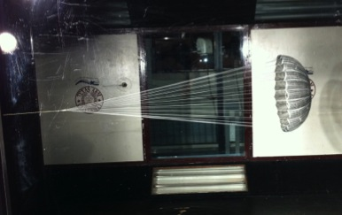
Test Facility: Texas A&M
Tunnel is closed loop atmospheric
Capable of 4778 Pa (100 psf) dynamic pressure (Re=2x10⁶)
Test section: 3x2.1x5.5 m (10x7x20 ft)
Clear walls for optical access
Model was mounted from the side wall on a steel strut
  Translates axially for x/d variation
  Rotates with respect to wall mount for capsule angle of attack
Airfoil fairing
Strut
Flow Direction
CM
Flow Direction
x/d variation
Strut Mount to Tunnel Wall
A.Sengupta et. Al., “Performance of a Conical Ribbon Drogue Parachute in the Wake of a Subscale Orion Command Module,” IEEE Aerospace Conference, Big Sky MT, March 2012.

Slide 5
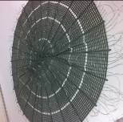

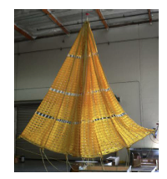
Parachute Test Article
10% of full scale conical ribbon drogue
  Do=0.7m (2.3 ft)
  Nylon and spectra construction
  Laser cut gore to simulate ribbons
  1st, and 2nd stage reefing was accomplished with a skirt reefing line
Subscale Gore Layout
Parameter | Symbol | Full Scale | Subscale
Parachute Type | --- | VPCR | VPCR
Nominal Diameter (m) | D_{o} | 7 | 0.7
Number of Gores | --- | 24 | 24
Number of Ribbons | --- | 52 | 52
Geometric Porosity | --- | 19.2% | 19%
Trailing Distance | x/d | 6 | 6-9.5
Reefing Ratio (%) | RR | 50-70 | 50-70
Reynolds Number (x10⁶) | Re | 1-7 | <3
Dynamic Pressure (kPa) | Q | 1.4-8 | 0.1-4.8
Mach Number | M | 0.1-0.7 | 0.1-0.3
Flow Direction
Full Scale
A.Sengupta et. Al., “Performance of a Conical Ribbon Drogue Parachute in the Wake of a Subscale Orion Command Module,” IEEE Aerospace Conference, Big Sky MT, March 2012.

Slide 6
CM Test Article
10% scale 0.49-m diameter Command Module (CM)
Trip dots to control/force transition
Capsule aero with internal force balance verified with IR thermography
Parachute aero with load cell
Capsule rotated on sting to explore 0, 30, and 50 deg angle of attack relative to the free stream (180, 150, 130 pitch plane)
Airfoil fairing
Flow Direction
Balance
Strut
Parachute lines
Flow Direction
Load Cell
CM
Force balance
Pressure Taps
Load cell
Trip Dots
A.Sengupta et. Al., “Performance of a Conical Ribbon Drogue Parachute in the Wake of a Subscale Orion Command Module,” IEEE Aerospace Conference, Big Sky MT, March 2012.
Load cell

Slide 7
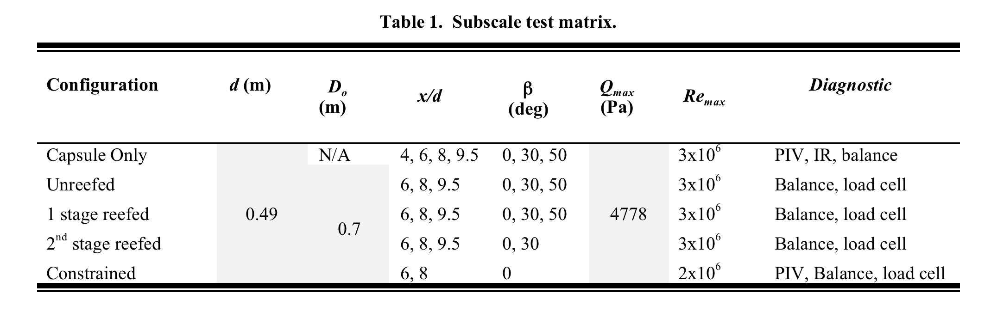
Test Matrix
Test matrix explored several parameters
  Full open, 1st, and 2nd stage reefed configurations
  Capsule angle of attack range of 0, 30, and 50 degree angle of attack relative to the free-stream
  Dynamic pressure from 10 to 100 psf explored (Re from 100,000 to 3,000,000)
  Trailing distance from x/d of 6. 8, and 9.5
  Capsule laminar to turbulent transition verified with IR thermography
A.Sengupta et. Al., “Performance of a Conical Ribbon Drogue Parachute in the Wake of a Subscale Orion Command Module,” IEEE Aerospace Conference, Big Sky MT, March 2012.

Slide 8
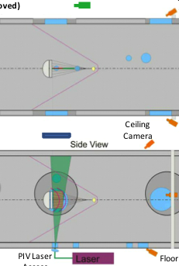
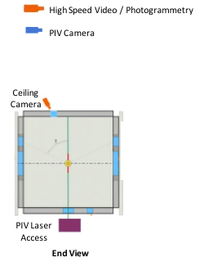
TAMU Optical Diagnostics Layout
Flow Direction
Side Camera
Profile Camera
Top View
Ceiling Camera
Side View
PIV Laser Sheet

Slide 9
Particle Image Velocimetry (PIV)
High spatial resolution velocimetric measurement
  3 components of velocity and turbulence statistics
  Ideal measurement for CFD validation
Flow seeding accomplished with mineral oil vaporization
Measurement conduct at several locations downstream of CM with and without parachute present in the tunnel
A.Sengupta et. Al., “Performance of a Conical Ribbon Drogue Parachute in the Wake of a Subscale Orion Command Module,” IEEE Aerospace Conference, Big Sky MT, March 2012.

Slide 10
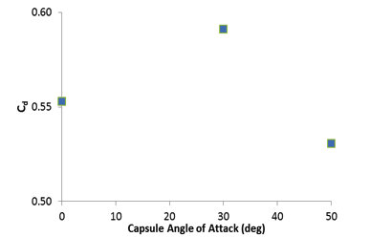
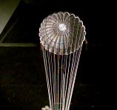
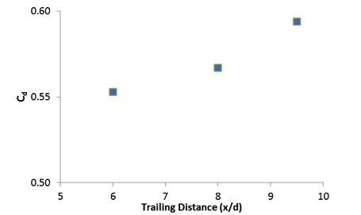
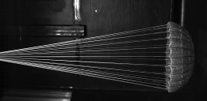
Unreefed Parachute Drag Measurement
Observations
  Maximum drag as 30 deg AOA
  Increase in drag with x/d
A.Sengupta et. Al., “Performance of a Conical Ribbon Drogue Parachute in the Wake of a Subscale Orion Command Module,” IEEE Aerospace Conference, Big Sky MT, March 2012.

Slide 11
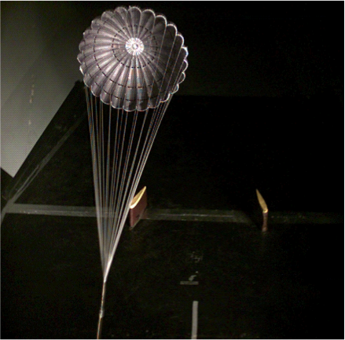
Unreefed Parachute Flight

Slide 12
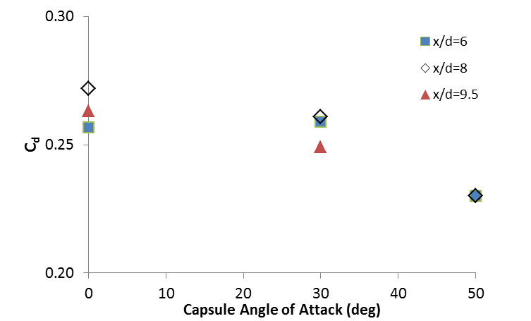
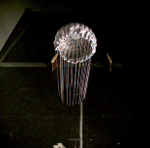

1st Stage Parachute Drag Measurement
Observations
  Reduction in drag with AOA
  Less motion than unreefed
  More skirt motion
A.Sengupta et. Al., “Performance of a Conical Ribbon Drogue Parachute in the Wake of a Subscale Orion Command Module,” IEEE Aerospace Conference, Big Sky MT, March 2012.

Slide 13
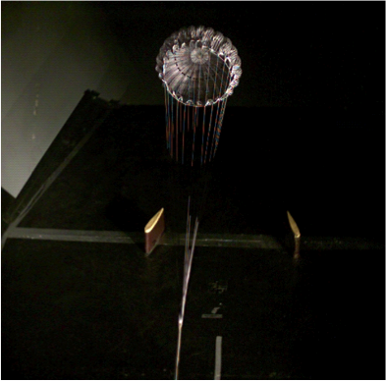
1st Stage Reefed Parachute Flight

Slide 14
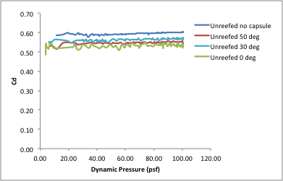
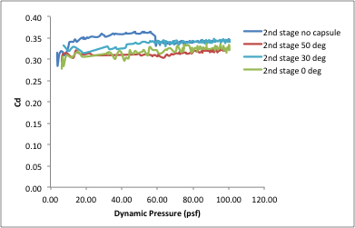
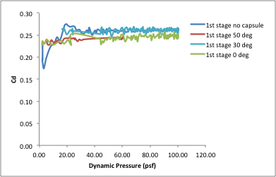
Drag Versus Dynamic Pressure

Slide 15
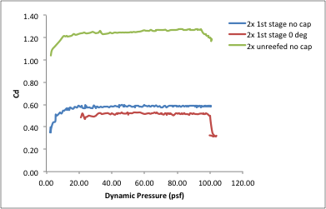
Two-Chute Drag Versus Dynamic Pressure

Slide 16
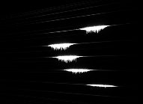
Example of PIV Results
Capsule Only
Axial
Cross Stream
Cross Stream
Parachute Present
A.Sengupta et. Al., “Performance of a Conical Ribbon Drogue Parachute in the Wake of a Subscale Orion Command Module,” IEEE Aerospace Conference, Big Sky MT, March 2012.

Slide 17
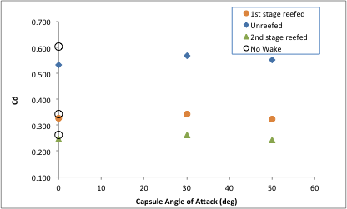
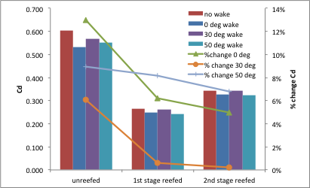
Comparison of Wake Effect and No Wake
A.Sengupta et. Al., “Performance of a Conical Ribbon Drogue Parachute in the Wake of a Subscale Orion Command Module,” IEEE Aerospace Conference, Big Sky MT, March 2012.

Slide 18
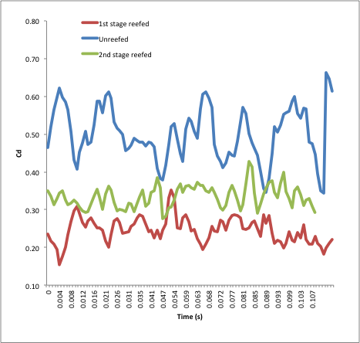
Frequency Analysis
Frequency component of parachute load in the 50 to 70 Hz range for cases with capsule present

Slide 19
Conclusions
Full matrix of aero data for a range of parameters
Subscale capsule drag is within 2% of full scale
Subscale parachute drag is within 5% of full scale
Parachute inflated shapes are similar for unreefed and reefed configurations
Capsule wake induces large load fluctuations but on average a reduced drag coefficient
Significant work remaining to reduce the dataset

