Slide 1
TECHNOLOGIES FOR A LONG DURATION LANDER ON THE SURFACE OF VENUS
Douglas S. Mehoke, Ralph D. Lorenz, Stuart W. Hill
The Johns Hopkins University Applied Physics Laboratory

Slide 2
Outline
Overview
Venus Mission Planning Evolution
Strawman Technology Demonstration Missions
  Venus Flagship Mission
  Venus Pathfinder Mission # 1
  Venus Pathfinder Mission # 2
Conclusions

Slide 3
Overview
This presentation summarizes the work done under the NASA GRC sponsored effort to look at technologies needed for a long duration Venus lander
It also provides some of the engineering detail behind a paper presented last year at IPPW8 by Ralph Lorenz
Venus Pathfinder – A Compact Long-Lived Lander
Significant technology development is needed to get a viable proposal ready for a long-term Venus lander in the next few years, but those technologies need to be focused on the desired mission
There is not one technology that will enable all potential missions but rather different technologies for different types of mission
Simpler technologies can be available earlier than the more complicated ones

Slide 4
Strawman Missions
To provide a basis for the technology development discussion, the study looked at three potential Venus lander missions
  A long term lander defined in the Mission Architecture Enhancements section of the 2009 Venus Flagship Study Report.
    400 W electrical load
    700 W thermal load
  A 50-200 day mission for a compact lander focused on meteorology and seismicity based on the IPPW8 Lorenz paper
    10 W electrical load
    70 W thermal load
  A 15 day all high-temperature lander
    1 W electrical load
    Primary battery powered
    Ambient temperature operation

Slide 5
NASA 2006 Solar Exploration System Roadmap
The NASA 2006 Solar Exploration System Roadmap recommended an aggressive exploration of Venus
Farther out there would be a Venus Sample return
Early mission demonstrated technologies in preparation for Flagship mission
Mobility and duration were critical technologies to be demonstrated
Environmental challenges will drive technology investment

Slide 6
NRC 2011 Decadal Survey
The NRC 2011 Decadal Survey lists VISE as a New Frontiers mission candidate
A Venus Climate Mission is listed as one of the five Flagship candidate missions
  The mission architecture includes
    a carrier spacecraft
    a balloon system
    a mini-probe
    two drops sondes
The report notes that many crucial analyses of Venus cannot be obtained from orbit, but that sample return appears beyond the scope of current technology
Both roadmap documents note the technical challenges of a long-term lander are limiting its inclusion in potential missions

Slide 7
Venus Flagship Mission Study – Design Reference Mission
2009 Venus Flagship study
  Target launch date 2020 to 2025
  Access to earlier technology validation experiments to enable or enhance mission
  Show path to future Venus Surface Sample return concept
Architecture elements
  Orbiter Relay support
  Entry system
    1969 kg each
    Carbon-Phenolic TPS, 2.65 m dia
  Short lived Lander 5 hours, may include long lived components
    686 kg; power 492 W Descent with telecom, 729 W surface ops with telecom
    0.9 m diameter shell (1 cm wall internal, 5 cm external insulation)
    Power 6 kW hrs, battery mass 12.6 kg
    Penetrations: windows, feed-thrus, tubes for pressure sampling

Slide 8
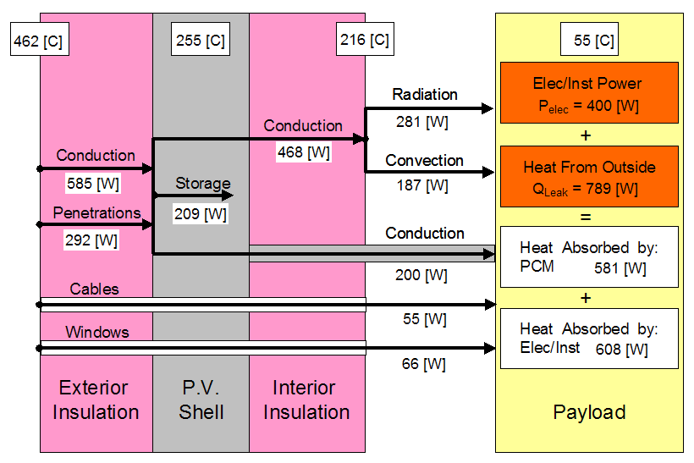
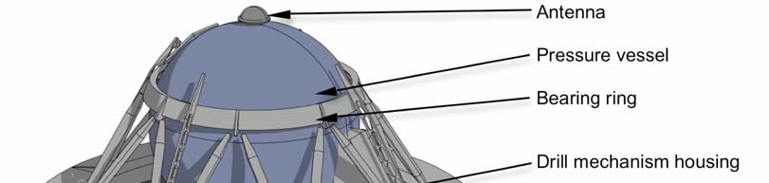
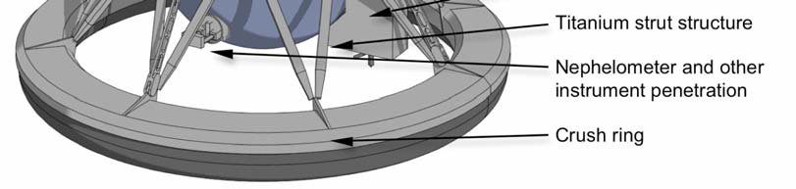
Venus Flagship Mission Study – Enhanced Mission
The first design case is the lander defined as part of the 2009 VFM Design Reference Mission
The Mission Architecture Enhancement section lists the benefits of a long-lived, refrigerated Lander with a near full compliment of DRM Lander capabilities operating for months

Slide 9
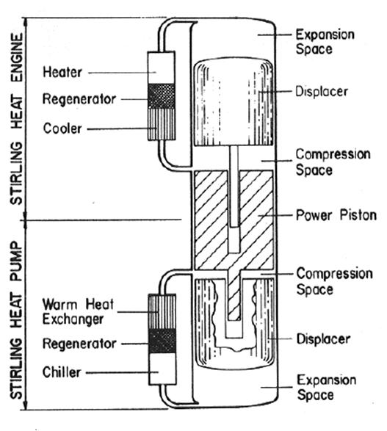
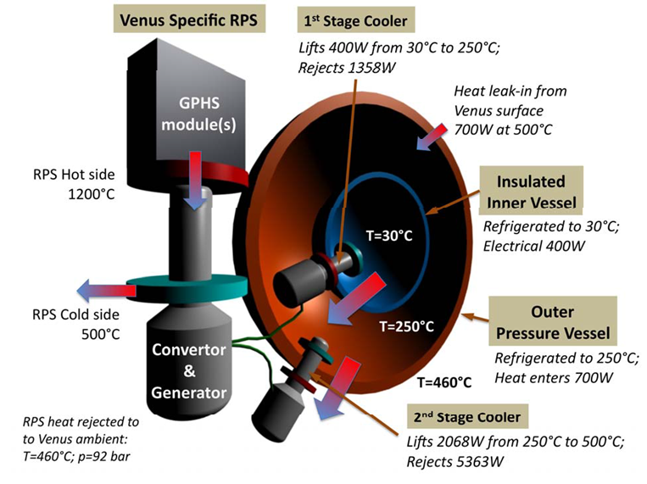
Venus Flagship Mission Study – Heat Balance
One technology enabling a long-lived mission is a Stirling Duplex engine that provides cooling to a protected enclosure
One, two, and three stage systems were looked at that required between 54 and 94 GPHS bricks
Penswick, L. B., and I. Urieli, Duplex Stirling Machines, 19th Annual Intersociety Energy Conversion Engineering Conference, San Francisco, CA, August 1984.
Venus Science and Technology Definition Team, Venus Flagship Mission Study, JPL, April

Slide 10
Venus Flagship Mission Study – Technology Challenges
Two driving technology challenges for the long-lived Lander of the VFM study
  High Duplex engine operating temperature – 1200C
  High heat flow from the GPHS bricks to the engine hot end
The 13,000 W to 23,000 W generated from the GPHS bricks need to be moved from the various bricks to the hot end of the engine, while the hot end of the GPHS pellets is limited to 1335C
  The needed thermal resistance is about 0.0077 to 0.0044 C/W
While there is a significant amount of experience with Stirling engines running at 850 C, controlling the material creep at 1200 C is a significant issue
  The use of the Venus atmospheric pressure to support the pressure differential across the engine is limited because of the effect it would have on the system temperatures and life testing

Slide 11
Venus Pathfinder Mission #1 - Concept
Lander concept, leveraged off APL asteroid lander study, produces a highly integrated and optimized design that maximizes use of available resources
Volume is a critical feature of the design
Long Term Lander
Early Operation, Sacrificial Package

Slide 12
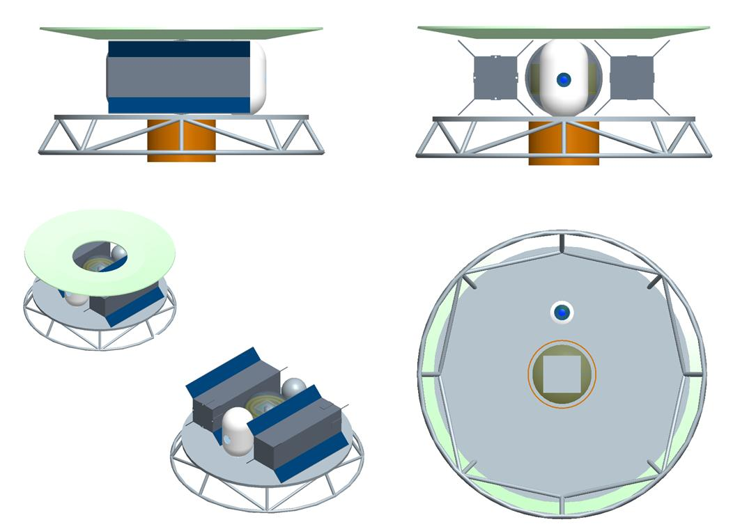
Venus Pathfinder Mission #1 – Strawman Configuration

Slide 13
Venus Pathfinder Mission #1 – Concept Description
Lander concept broken into two distinct packages
  Long lived package, consisting of power, cooling, instruments and avionics
  Early operation sacrificial package, consisting of descent and panoramic imagers, battery and avionics
Segregation of these two packages greatly reduces the cooling requirements on the long lived portion of the lander
  Less components, smaller volume, fewer feed-thrus
Long lived package contains primary science package for long-term measurements
  Small volume enclosure to minimize cooling requirements for long-term mission
  Designed to reduce overall heat leak into the system
  External energy production system for long term survival
  Active temperature control provided by external cooling system
  Dedicated telecomm system provides data link to mothership or Earth
Early operation sacrificial package is self-contained system with dedicated telecomm
  Dedicated telecomm provides both uplink and downlink capability
  Uplink capability will be used during descent for navigation and ranging
  Downlink will be used to transmit data from imagers during early operations (0-3 hrs)
  Passive temperature control via phase change material, providing ~1-3 hrs of protection following landing
  Power provided by dedicated batteries that will provide 1-3hrs of imager, avionics and telecomm operation

Slide 14
Venus Pathfinder Mission #1 – Early Operation Sacrificial Package
Separately mounted package that will be used during descent and early operations following landing (1-3hrs)
Science instrumentation consists of a descent imager and a panoramic imager that only need to survive for a short time following landing
  Descent imager captures images during descent and documents landing site
  Panoramic imager will capture views of the landing site from the ground following landing
Once on surface, images of the horizon are not expected to change over the duration of the mission
  No need to maintain an imaging package for long term measurements
  Reduces requirements on the long lived portion of the lander
Science and housekeeping data will be stored by a dedicated avionics system, separate from the long lived portion of the lander
Data transmitted back via a dedicated telecomm system and antenna
  Telecomm system will have both up & down-link capability
  Will be used during descent to perform navigation and ranging of the probe
All components in this package will mounted in a vacuum sealed sphere, with passive cooling to ensure 1-3hrs of life following landing
  Once overheated, systems will no longer operate, and the package will not require any resources from the long lived package

Slide 15
Venus Pathfinder Mission #1 – Long Lived Package
Consists of three instruments that exploit long duration
  Magnetometer – internal instrument, enhanced by orbiter magnetometer (if included)
  Seismometer – external instrument, deployed following landing to decouple from lander
  Metrology package - including pressure, temperature, wind speed, wind direction and light level
    Wind speed, direction, temp sensors external instruments
    Pressure gauge internal instrument with aperture to outside
    Sky brightness sensors internal instrument with ‘widows’ thru lander
Lander avionics, power distribution and telecomm systems all highly integrated, single card systems
  Allows for a small packaging envelope, reducing power requirements for operation and cooling
Total power dissipation during normal operations will be ~5-10W total
All internal components mounted to a dewar-like mounted central structure within a vacuum sealed sphere
Package requires an external energy and cooling system for long term operations

Slide 16
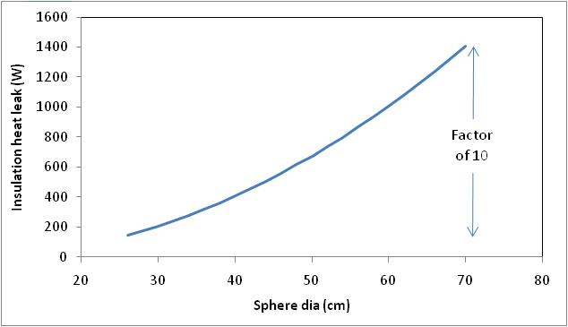
Venus Pathfinder Mission #1 – Cooling Requirements
Example: Pioneer Venus Large Probe
  Launched May 1978
  41 layer MLI blanket, eff k = 0.06 W/m K
  72 cm sphere
  17 experiments
An additional 600 W is estimated for the feed-throughs
Insulation heat leak
  The cooling heat leak includes the area-based, insulation leak and point losses through breaks in the insulation
  Minimizing these heat leaks is critical to bounding the size and mass of the entire design
Lander estimate

Slide 17
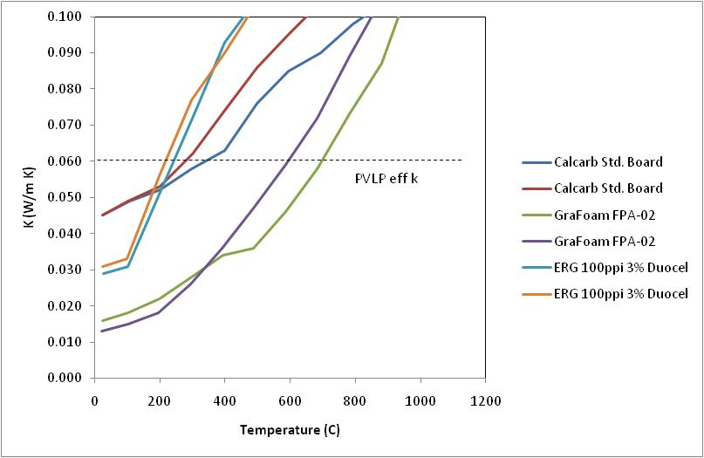
Venus Pathfinder Mission #1 – Cooling Requirements
Controlling heat leaks is critical
  No apertures are allowed and all harness feed-thrus have long paths and use low thermal-conductivity wire
Test data of several carbon foam shows there are better insulating materials
Lander insulation range

Slide 18
Venus Pathfinder Mission #1 – Heat Balance
A nominal heat balance and design goal are given for the Lander concept
Lander heat balance Goal SOA
  Internal Power dissipation 5 W 10 W
  Insulation heat leak 40 W 70 W
  Feed thru het leak 10 W 50 W
  Margin 28 W 65 W
  Total 83 W 195 W
The power system would need to be designed to provide at least 200 W
  The number of GPHS bricks is estimated to be about 8

Slide 19
Venus Pathfinder Mission #1 – Technology Challenges
The Pathfinder #1 design can take advantage of technology plan at NASA GRC
  Stirling Duplex System operating at near-normal hot end temperatures is much closer to being demonstrated
  There is active high-temperature sensors development underway supporting in situ engine diagnostics
  The new Venus environment chamber allows realistic life-testing
These capabilities may be short-lived as the priorities from other programs and the recommendation of the 2011 Decadal Survey are assessed

Slide 20
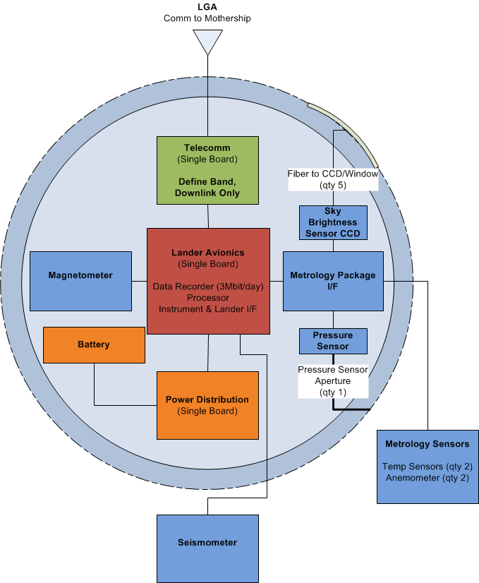
Venus Pathfinder Mission #2
Architecture elements
  Orbiter Relay
  Entry system
Long-Lived Lander
  15 days, across sunrise (or sunset)
  Power 1 We payload, ambient temperature operation
  Battery sizing 470 W-hrs
  Data processing in orbiter
Target landing zone
  +/- 7.5 degrees (vary as cosine of latitude)
  Lower latitude preferred to maximize sunlight
  Combining dawn/dusk time, entry angle constraints, and geological sites may be difficult

Slide 21
Venus Pathfinder Mission #2 - Technology Challenges
The Pathfinder #2 design needs a directed technology plan to develop a high temperature system
  The need for high temperature electronics, as opposed to sensors, requires experience with data handling and calibration
  High temperature batteries have to be optimized for the Venus environment and demonstrate their long term performance at temperature
In the longer term, the high temperature system, if developed, will probably offer more mission options

Slide 22
Conclusions
There are a range of different technologies that support different types of missions.
The large power and cooling needs of the VFM-type mission requires an ambitious technology plan and a multiple year commitment
  Ultimately, it provides the largest return
A mission approach combining a short term lander with a long term seismicity/meteorology package provides compelling science with a simpler technology development plan that is achievable sooner
  It probably has shortest developmental timeline
A shorter term mission, potentially including one or more smaller, high-temperature landers would be the simplest overall system
  A longer term technology development plan is needed

Slide 23
Acknowledgment
This work was supported by a contract with NASA Glenn Research Center. The support of Terry O’Malley and Roger Dyson is appreciated.

