Slide 1
Status of the MEDLI Integrated Sensor Plug (MISP) Hardware and Data Reconstruction Effort
9th International Planetary Probe Workshop, Toulouse, France
Session 5: Mars
June 19th, 2012
Deepak Bose (TSA) – NASA ARC
Jay Feldman (TSM) – ERC, Incorporated
Bernie Laub (TSS) – NASA ARC
Milad Mahzari – GA Tech SSDL
Jose Santos (TSF) – Jacobs Engineering
David Saunders (TSA) – ERC, Incorporated
Todd White (TSA) – ERC, Incorporated

Slide 2
Context
Motivation
An accurate understanding of the entry environment and thermal protection system (TPS) response for Mars Science Laboratory (MSL) is vital for future missions to Mars. MEDLI-MISP is an embedded sensor system in the MSL heatshield, and will provide an important dataset for future heatshield designs.
Outline
Overview of MEDLI/MISP instrumentation
Updates to live data stream channels
Cruise checkout and quick-look data products
Preparations for reconstruction activities
  Arc jet testing
  PICA material characterization
  Simulations and tool development
Conclusions
2

Slide 3
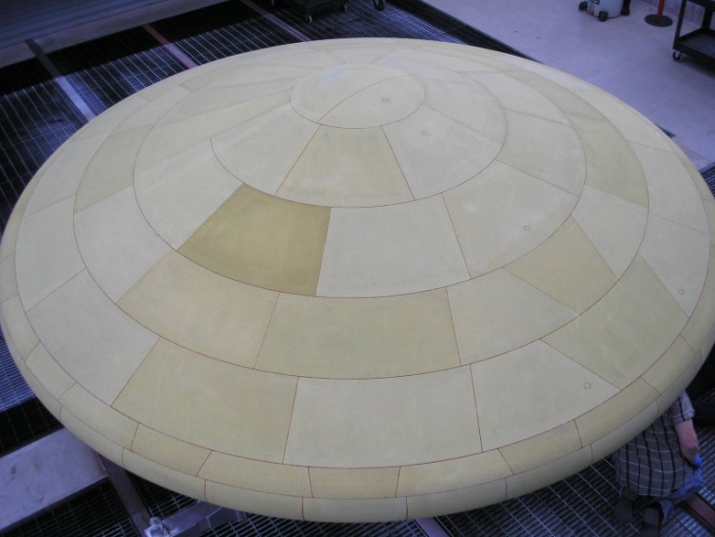
Overview of MEDLI/MISP
Mars Science Laboratory (MSL) has a 4.5m diameter PICA tiled heatshield. It launched in November 26th 2011, and will enter Mars August 5th PDT.
The heatshield is instrumented via the MSL Entry Descent and Landing Instrumentation (MEDLI) suite, with three main components:
  MEADS (Mars Entry Atmospheric Data System) Pressure ports and transducers at 7 locations,
  MISP (MEDLI Integrated Sensor Plug),
  In-depth sensors at 7 locations embedded in the TPS,
  Solid State Electronics (SSE) box for data collection from MISP and MEADS.
Data is stored during entry, and telemetered after landing, except for tones and a limited live data stream.
MSL heatshield
MISP installed on heatshield
MISP T5
MISP T7
MISP T6
3

Slide 4
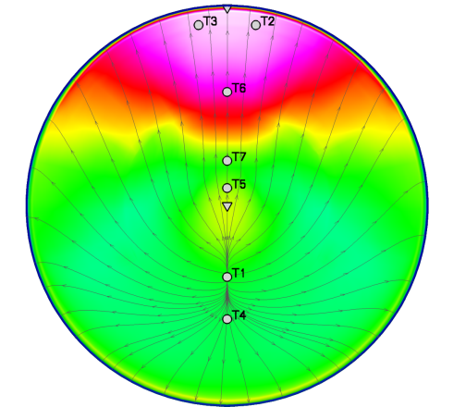
Overview of MISP locations and sensors
MISP cross-section
Location of MISPs on MSL heatshield
HEAT sensor
Leeside
Windside
Each MISP is a 1.3” x1.25” long cylindrical PICA plug bonded into the heatshield
A single MISP contains four thermocouples (TC1-4) and one HEAT (Hollow aErothermal Ablation and Temperature) sensor sampled at 8, 2, or 1 Hz depending on depth.
There are seven MISP installed on the heatshield (T1-T7)
MEDLI/MISP is the most heatshield instrumentation flown on a Mars mission to date!
4

Slide 5
Updates to live data stream channels
MSL will return a limited tone data, and a live data stream from the MEDLI subsystem during entry:
The live data may be useful in the event of delays in the full MEDLI data dump or if the probe is lost prior to landing,
In late January, MISP team recommended updated channels, to:
  Improve redundancy in the leeside shoulder area for forensics and instrument diagnostics,
  Protect against sensor anomalies or failure by polling more TCs at 1 Hz (rather than 2 Hz),
  Poll HEAT sensor and TC in same plug to corroborate isotherm location between HEAT and TC (and adjust HEAT for in-plug thermal gradient).
These channel updates have been sucessfully pushed to the spacecraft.
Live data stream channels on heatshield
Leeside
TC3 & HEAT
TC3 & HEAT
TC2
TC2
TC2
TC2
Windside
5

Slide 6
Cruise checkout and quick-look data products
In March 2012, the MEDLI subsystem was powered-on for several hours.
  The MEDLI electronics box gathered data on MEADS, MISP, and internal SSE temperatures.
  Small temperature gradients (<10 K) observed through the thickness of the TPS.
  All connected MISP channels appear operational!
After receipt of full dataset from entry, we can provide these quick-look products:
  Assessment of MISP TC and HEAT instrument signal quality,
  Estimate of TPS/sub-structure bond-line temperature profile,
  An upper bound on recession at each of the seven MISP locations.
The MISP team is working to address MEDLI science objectives of:
  Reconstructing aeroheating across heatshield,
  Determining degree of turbulent heating,
  Assessing recession and in-depth TPS performance.
MISP team is engaged in three main activities prior to landing.
6

Slide 7
Reconstruction activities prior to entry
MEDLI-MISP
2) Material Property Testing
Characterize flight-plug PICA properties and quantify uncertainty/ variability
MEDLI-MEADS
MSL
HEAT Data
TC Data
Pressure Data
Estimated Trajectory
1) Instrument Calibration and
Arc jet Testing
Calibrate sensors at flight relevant conditions to reduce measurement uncertainties
Develop data reduction procedures
Processing
Processing
Material Prop.
validation
In-depth Temperature vs. Time
FIAT-INV
(Charring Ablation Code)
DPLR
(CFD Code)
Pressure and Enthalpy vs. Time
Isotherm Depth vs. Time
3) Analysis Technique Development
Develop post-flight data analysis tools to meet MISP Science Objectives
Heat Flux, Recession vs. Time
Heat Flux vs. Time
Add Biases
Compare
7

Slide 8
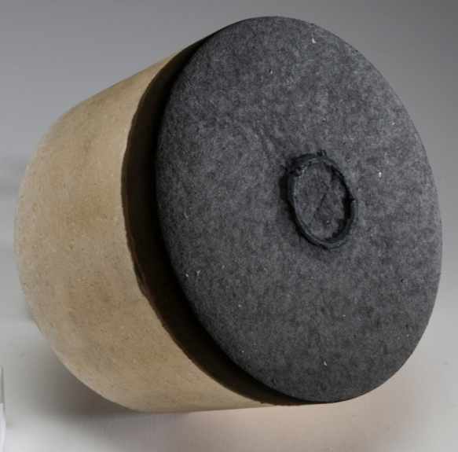
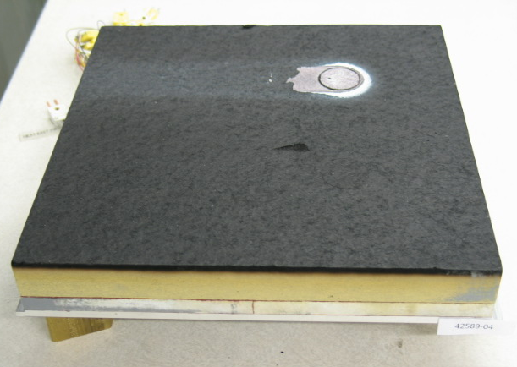
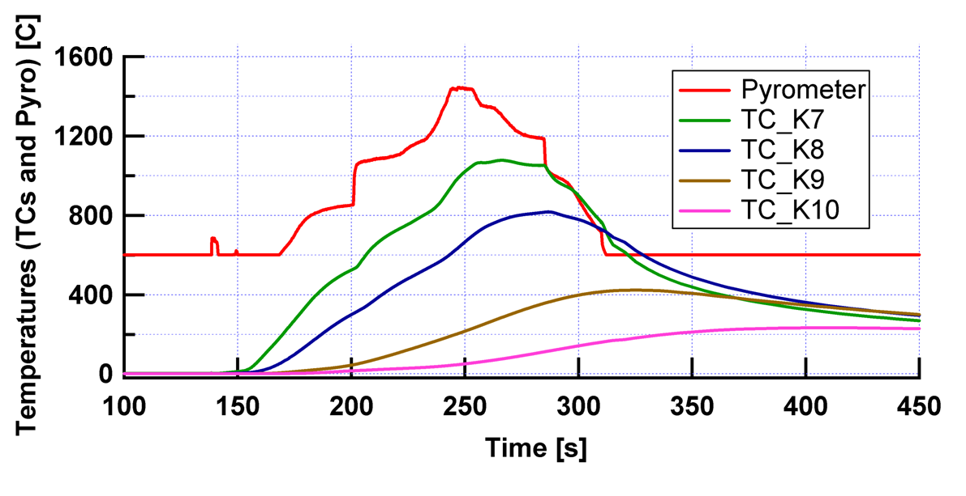
1) Instrument calibration and arc jet testing
Bonding agent build-up
In arc jet testing we seek to:
  Test and calibrate sensors at flight relevant conditions to quantify and reduce measurement uncertainties,
  Develop data reduction procedures for the MISP flight data return.
  Our testing has several objectives:
Thermocouple Studies
  Quantify TC thermal lag relative to
  surrounding PICA
  Assess high temperature (>1000 C) performance of Type-K thermocouple
HEAT Sensor Correction & data processing
  Determine isotherm temperature at high heat rates
  Determine depth accuracy of HEAT
Testing in Flight-Like Environment
  Assess effect of bonding agent build up
  Verify performance in time-varying heating environment
  Generate thick char layers for PICA material characterization
Shear flow
Flow
MISP TCs exposed to time-varying heating
8

Slide 9
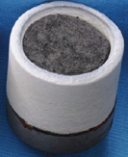
2) PICA Material property characterization
We need to better understand PICA in the MISP plugs, because
PICA material property variability is significant:
  The current thermal response model for PICA is for average PICA properties, not necessarily representative of MISP PICA,
  Goal: Hone model for the PICA material used to make the MISPs & obtain statistics on properties for uncertainty analysis.
Our arc jet databases are built from testing PICA in air:
  We need to verify that air- and CO₂-tested material have similar char structure & properties,
  Goal: Characterize any differences in properties or structure resulting from arc jet test gas environment.
We’ve completed the first phase of characterization, where we:
  Selected PICA from the same billet and near in proximity to the MISP material and subjected it to HyMETS arc jet testing in air, CO₂, N₂,
  Characterized virgin and char properties that are crucial to response modeling,
  Looked for differences in properties and material morphology attributable to test gas given that response models are built on PICA tested in air.
HyMETS CO₂ PICA sample
PICA property measurements:
Bulk density
Density gradient
Morphology and Composition
Thermal conductivity
Specific heat via differential
9

Slide 10
3) Analysis technique development
We perform reacting Navier-Stokes simulations along MSL trajectories (using DPLR), to:
  Perform sensitivity studies of important phenomena, such as transition, gas surface interaction, local geometric features,
  Generate simulated MISP responses for use in dry runs.
We are updating our flow solvers and material response codes (such as FIAT) to support data reconstruction.
We are also developing codes to solve the inverse-heat conduction problem—these map in-depth temperature measurements to surface heating.
  These codes are optimizers that find best fit to TC data with plausible heat pulse at each MISP,
  Alternatively, we can try to optimize ablator material response model based on test data.
  These codes have already been applied to arc jet test data, and Mars heatshield TC data from Pathfinder.
Inverse methods applied to Pathfinder TC*
* Mahzari, et.. al “Re-assessment of Mars Pathfinder Entry Temperature Data Using Inverse Methods “, AIAA 2012 Thermophysics
10

Slide 11
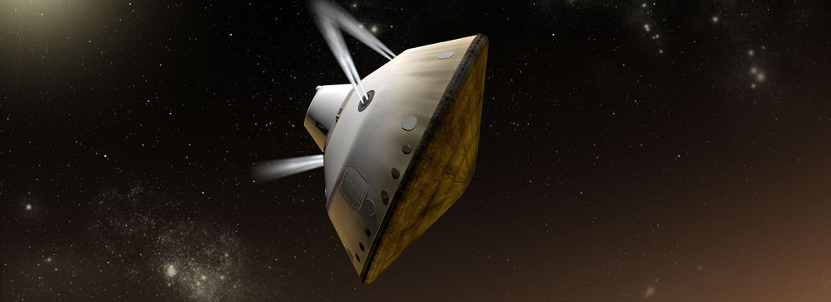
Conclusion
All MISP sensors appear are operating properly, and we will have useful live data channels
MISP Quick-look analysis is planned, and more detailed activities for full reconstruction are underway
MEDLI/MISP will be the most heatshield instrumentation flown on a Mars mission yet
The MEDLI/MISP suite is an incredible opportunity to understand heatshield performance and aerothermal environments at Mars!
MSL on August 5th, 2012
11

Slide 12

Acknowledgements
Portions of this work are being performed under:
NASA contract NNA10DE12C to ERC, Incorporated,
NASA contract NNA09DB39C to Jacobs Engineering,
NASA grant NNX12AF94A from the NRA Research Opportunities in Aeronautics
Questions?
12

Slide 13
Backup
13

Slide 14
Abstract
The Mars Science Laboratory (MSL) Entry, Descent and Landing Instrumentation (MEDLI) hardware was launched on its way to Mars in November 2011. A team of engineers on the ground continues to make preparations for data return in August 2012. This work will present the status of the MEDLI Integrated Sensor Plug (MISP) portion of the MEDLI system. Hardware health status and readings of the cruise phase heatshield temperatures were obtained during a power-on in March 2012. The reconstruction team has continued to refine the tones and real-time data returned during entry. Most importantly, arc jet testing of the MISP plugs and material property characterization, as well as both computational fluid dynamics and ablator simulations are ongoing to ensure the returned data can be used to improve future entry designs.
The MISP reconstruction approach involves reconstructing the ablator response for each plug, then combining the series of instrumented plugs to assess overall heatshield performance and aerothermal environments. This work will present details of the ground testing, simulation efforts, and anticipated post-flight analysis procedure.
14

Slide 15
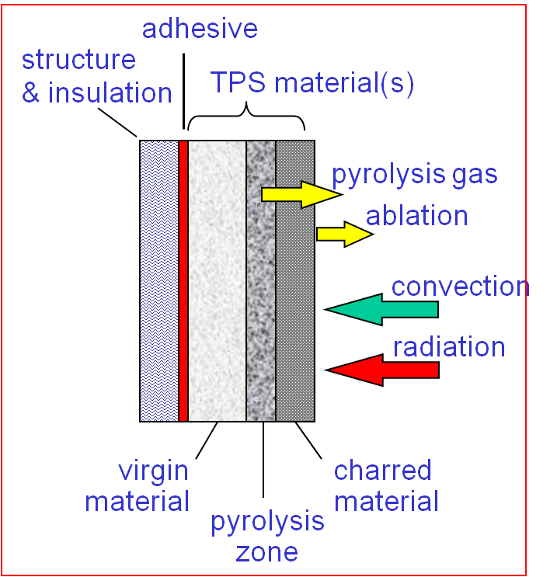
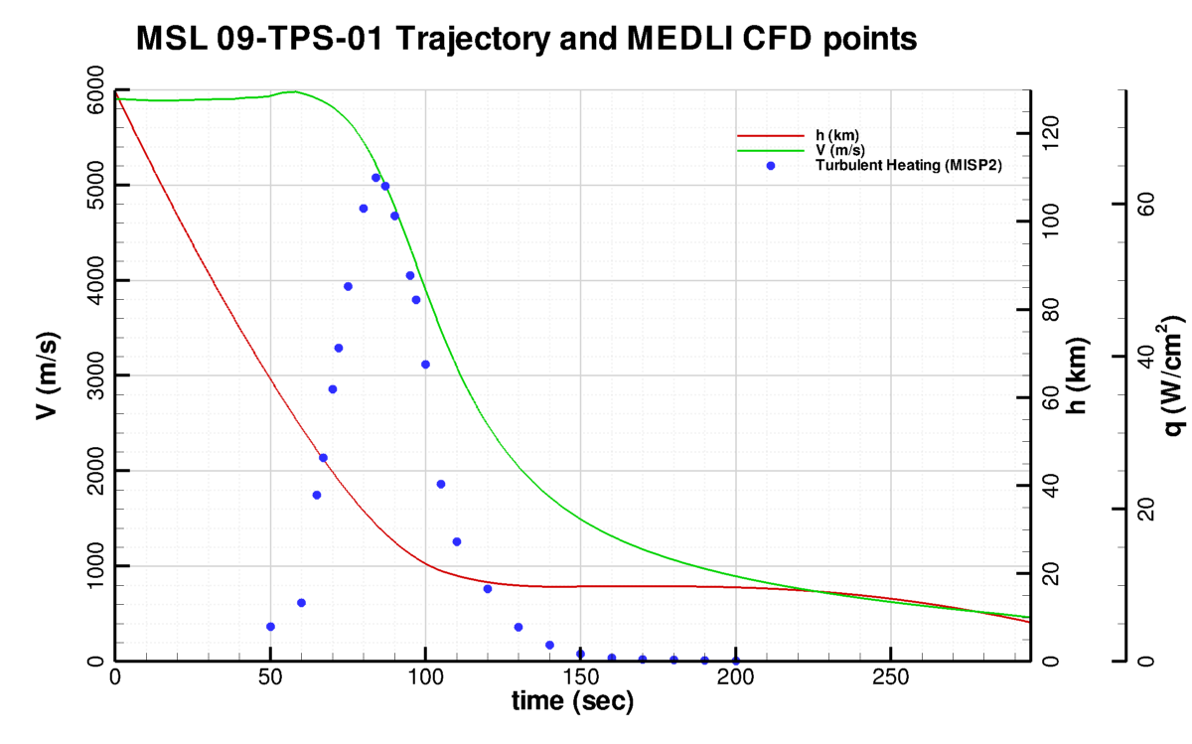
Modeling tools
DPLR (Flowfield simulations)
3D Hypersonic CFD for Aerothermal Environments use DPLR v4-02-2. DPLR is a parallel code requiring hours for each simulation
DPLR is run using Mitcheltree & Gnoffo Mars atmosphere and reactions (CO₂, CO, N₂, O₂, NO, C, N, O), radiative equilibrium Mitcheltree surface catalycity model, and several turbulence models (SST, B-L, B-L w/ specified transition)
Aeroheating environments are generated along a given trajectory as series of steady-state simulations
FIAT (Material simulations)
1D ablator response is modeled with FIAT v2.6. FIAT is a serial code requiring seconds to minutes for each simulation
Our analysis currently uses FIAT PICA model v3.3, the same used for MSL TPS sizing and design. We expect to update this model for our specific MISP PICA using ongoing material property and arc jet testing

Slide 16
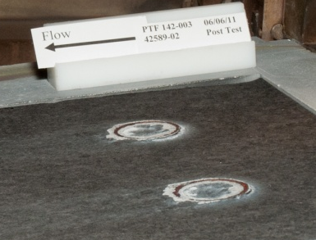
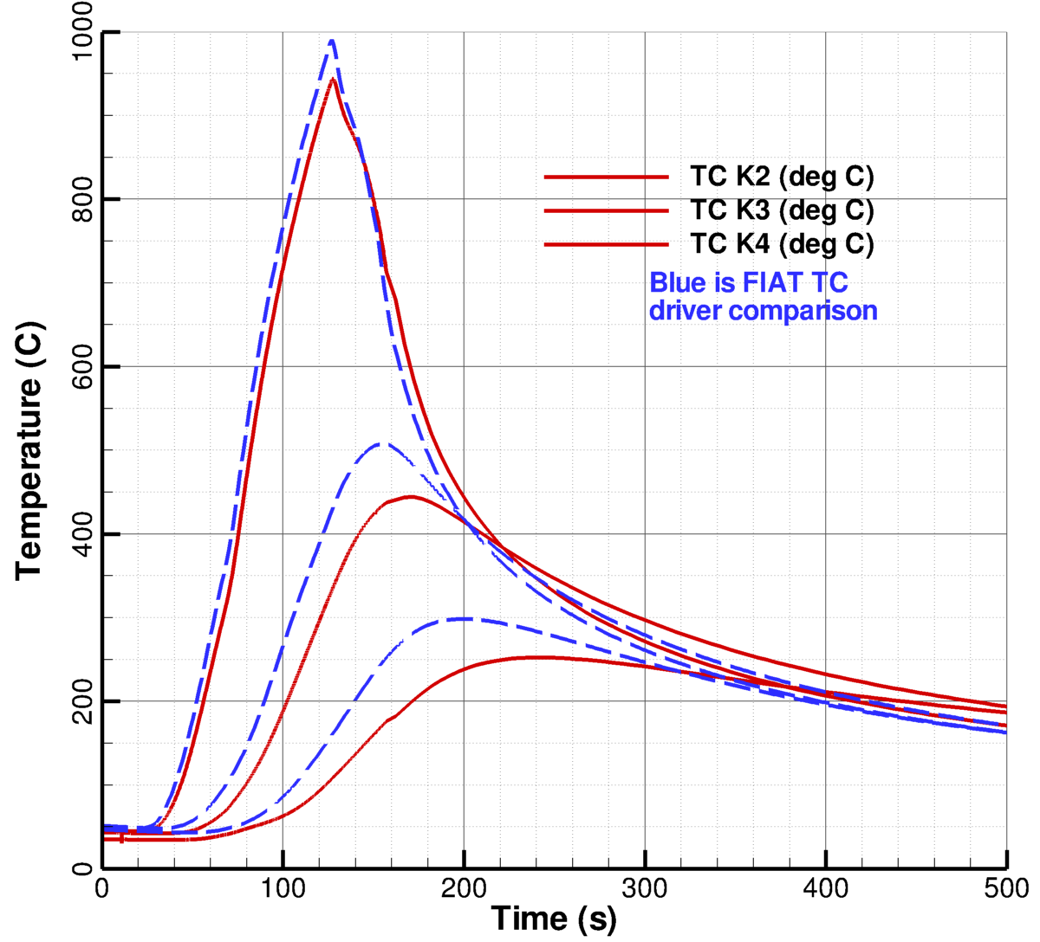
Ongoing work and challenges
To demonstrate inverse technique can work, we have to address several issues:
Sensor Modeling:
  Need to treat HEAT sensors as monotonically increasing depth measurements
  Need to crop/ignore TCs when outside temperature range
  Need to determine how to interpret TC burn-outs to infer recession
Differences between FIAT PICA model and MISP reality
  How do we effectively “tweak” material model in inverse methodology to avoid non-uniqueness, while making consistent model decisions across all MISP plugs
  How do we identify and compensate for surface features: For example, the so-called “caldera effect” where RTV bulges: Testing and dedicated CFD
  Accuracy of model before surface reaches equilibrium (will tend to over-predict recession)
  Verify with 3D FEA that 1D assumption is valid in the plug
We have begun to apply these “inverse engines” on the following problems:
  Arc jet data
  Mars Pathfinder: Flight TC data with a different ablators
  Simulated “blind tests” using aerothermal environments
RTV swelling and silica deposit observed in June 2011 PTF tests
FIAT analysis and PTF data
for Run #2 (45 W/cm²)

Slide 17
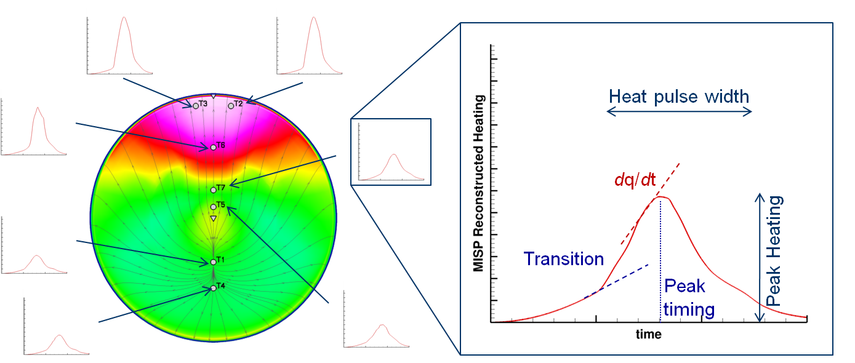
Heating profile comparison
Each reconstructed heat pulse may be characterized by several metrics, at least:
  Peak heating and time of peak
  Heat pulse width and integrated load
  Slope changes
We expect to characterize a database of anticipated phenomenon based on such metrics.
For example, turbulent transition and heating augmentation should be discerned at a plug based on a slope change.
Simulated heating pulses
across the heatshield

